Slide 1
Аукционы: Bayesian Approximation
Mechanism and Game Design
Лекция 5
Nick Gravin (Николай Гравин)

Slide 2
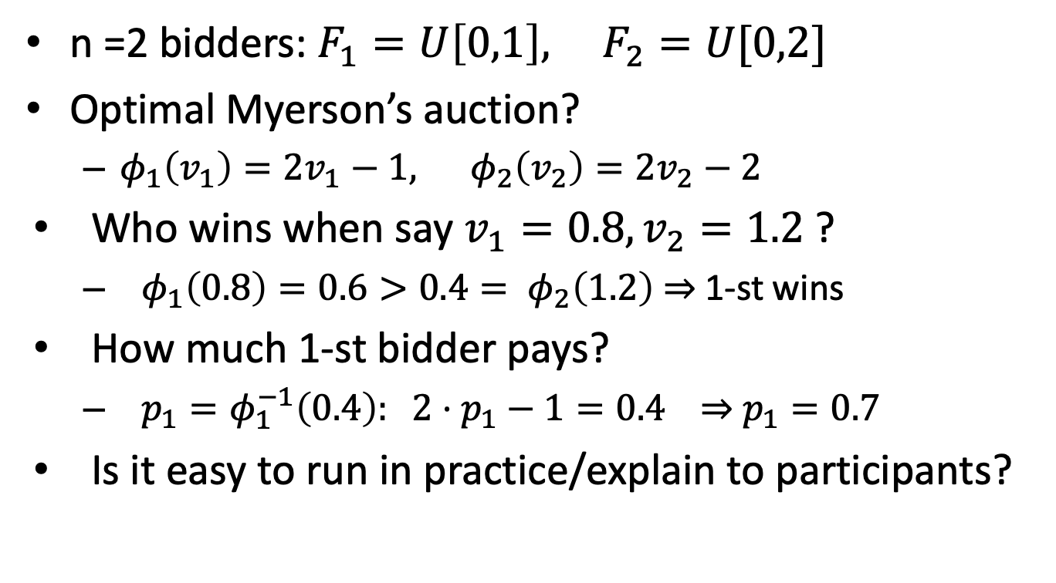
Example
n =2 bidders: $F_{1}=U\left[0,1\right], F_{2}=U[0,2]$
Optimal Myerson’s auction?
  $φ_{1}\left(v_{1}\right)=2v_{1}−1, φ_{2}\left(v_{2}\right)=2v_{2}−2$
Who wins when say $v_{1}=0.8, v_{2}=1.2$?
  $φ_{1}\left(0.8\right)=0.6>0.4= φ_{2}\left(1.2\right)$ $⇒$ 1-st wins
How much 1-st bidder pays?
  ${p_{1}=φ}_{1}^{−1}\left(0.4\right): 2⋅p_{1}−1=0.4$ $⇒$ $p_{1}=0.7$
Is it easy to run in practice/explain to participants?

Slide 3
Practical Mechanisms
Optimal Auctions
  Hard to run in practice
  Hard to explain to people
  Need to verify identity of the participants
  Format depends a lot on the prior distributions
Practical (simple) auctions
  E.g. second price auctioin
  How much these formats loose compared to the optimum?

Slide 4
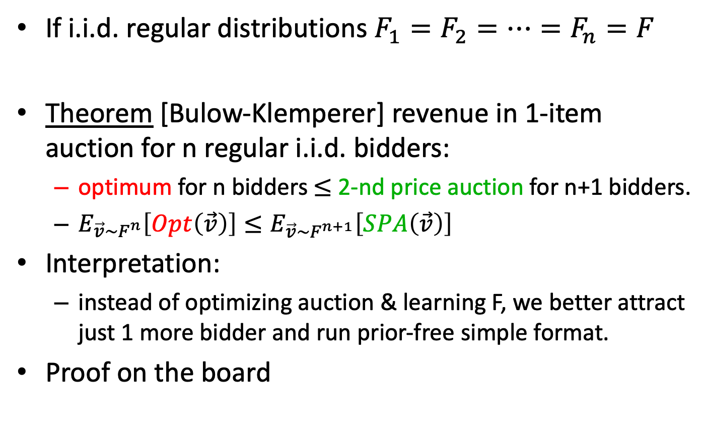
Bulow-Klemperer Result
If i.i.d. regular distributions $F_{1}=F_{2}=…=F_{n}=F$
Theorem [Bulow-Klemperer] revenue in 1-item auction for n regular i.i.d. bidders:
  optimum for n bidders $≤$ 2-nd price auction for n+1 bidders.
  $E_{\vec{v}∼F^{n}}\left[Opt\left(\vec{v}\right)\right]≤E_{\vec{v}∼F^{n+1}}\left[SPA\left(\vec{v}\right)\right]$
Interpretation:
  instead of optimizing auction & learning F, we better attract just 1 more bidder and run prior-free simple format.
Proof on the board

Slide 5





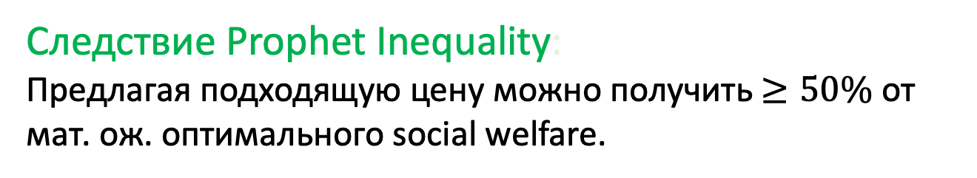

Sequential Posted Prices
1 товар на продажу, n покупателей, независимые типы $v_{i} \sim D_{i}$.
Покупатели приходят по одному, в произвольном порядке.
Для $∀$ покупателя: понимаем происходит ли сделка и по какой цене.
$$v_{1} \sim D_{1}$$
$$v_{2} \sim D_{2}$$
$$v_{3} \sim D_{3}$$
$$v_{4} \sim D_{4}$$
Следствие Prophet Inequality:
Предлагая подходящую цену можно получить $≥50\%$ от мат. ож. оптимального social welfare.
[Hajiaghayi Kleinberg Sandholm ’07]

Slide 6
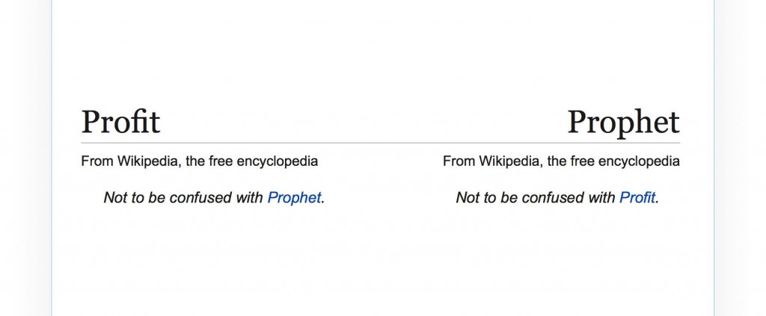
Неравенства пророка (prophet)
Неравенство для онлайн + стохастической оптимизации

Slide 7
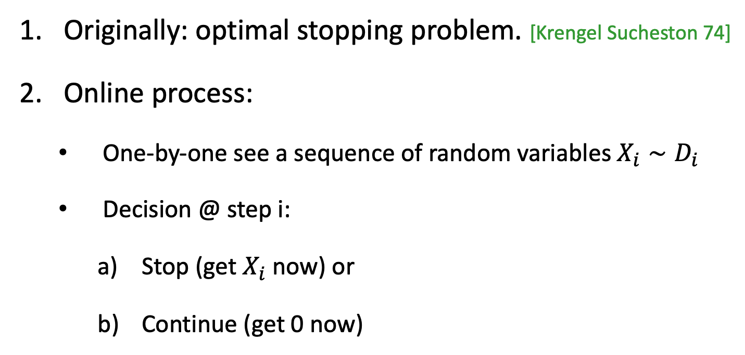
Prophet inequality
Originally: optimal stopping problem. [Krengel Sucheston 74]
Online process:
  One-by-one see a sequence of random variables $X_{i}∼D_{i}$
  Decision @ step i:
    Stop (get $X_{i}$ now) or
    Continue (get 0 now)

Slide 8
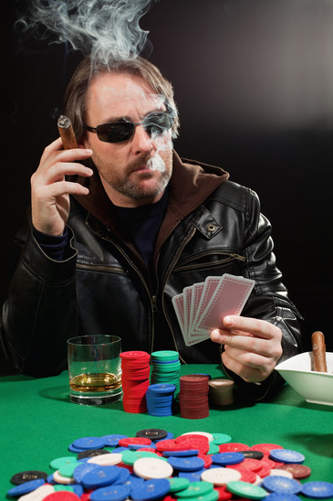
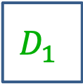
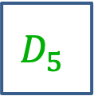
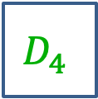
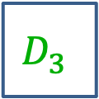
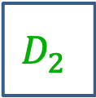
Prophet Inequality
Задача для игрока:
$$D_{1}$$
$$D_{2}$$
$$D_{3}$$
$$D_{4}$$
$$D_{5}$$
Notes:
Describing prophet inequality as a game

Slide 9
Prophet Inequality
Задача для игрока:
$20
$$D_{1}$$
$$D_{2}$$
$$D_{3}$$
$$D_{4}$$
$$D_{5}$$
Сохранить: выигрыш $20, остановить игру.
выбросить: потерять выигрыш, игра продолжается со следующей коробки.
Notes:
Boxes arrive and are opened one by one.
Gambler chooses whether to keep the prize (end game), or move on.
The distributions from which prizes are drawn are known in advance. Independent across boxes.

Slide 10
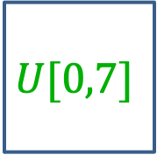
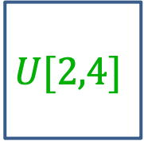
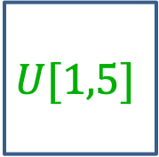
Давайте сыграем…
3.16
2.87
1.14
2.67
$$U[2,4]$$
$$U[2,4]$$
$$U[1,5]$$
$$U[0,7]$$

Slide 11
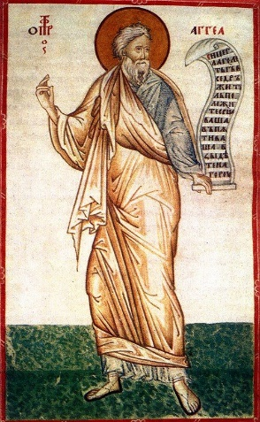
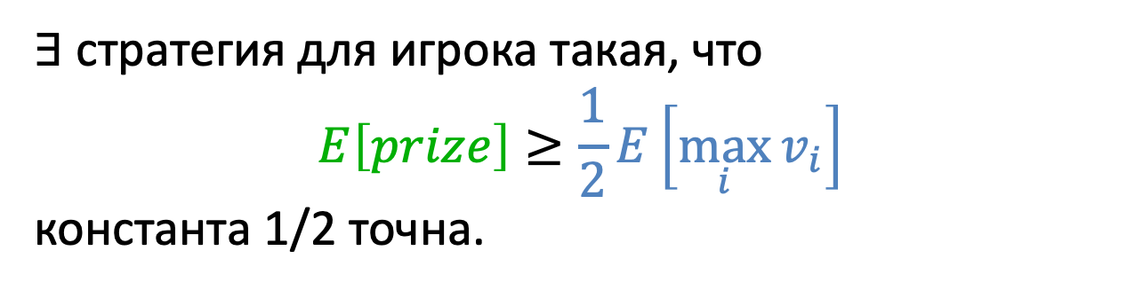
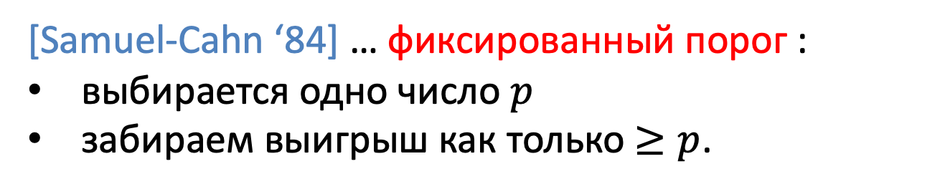
Prophet Inequality
Theorem. [Krengel, Sucheston, Garling ‘77]
$∃$ стратегия для игрока такая, что
$$E\left[prize\right]≥\frac{1}{2}E\left[\max_{i}{v_{i}}\right]$$
константа 1/2 точна.
[Samuel-Cahn ‘84] … фиксированный порог :
выбирается одно число $p$
забираем выигрыш как только $≥p$.
Notes:
Prophet Haggai

Slide 12

Оценка 1/2 точна
$\frac{1}{ε}$ w.p. $ε$
0 otherwise
1

Slide 13

Online Algorithms
Expected value of the optimal offline algorithm
$$E\left[prize\right]≥\frac{1}{2}E\left[\max_{i}{v_{i}}\right]$$
Expected value of the online algorithm
Competitive ratio
Notes:
Prophet Haggai

Slide 14

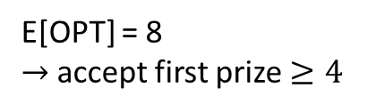
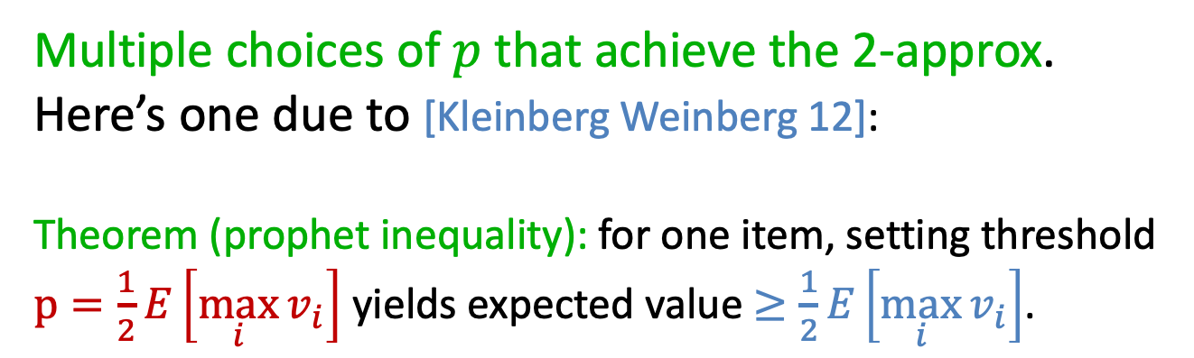
Prophet Inequality
Multiple choices of $p$ that achieve the 2-approx.
Here’s one due to [Kleinberg Weinberg 12]:
Theorem (prophet inequality): for one item, setting threshold $p=\frac{1}{2}E\left[\max_{i}{v_{i}}\right]$ yields expected value $≥\frac{1}{2}E\left[\max_{i}{v_{i}}\right]$.
Example:
10 w.p. 1/2
8 w.p. 1/4
6 w.p. 1/8
2 w.p. 1/8
OPT =
1 or 6
0 or 8
2 or 10
E[OPT] = 8
$→$accept first prize $≥4$
(each box: prizes equally likely)
Notes:
Note: not optimal! (Price 2 is better)
Also: comparison with optimal ex-post, not with the optimal price!
Also note: threshold p depends on the set of distributions, but not the arrival order!

Slide 15

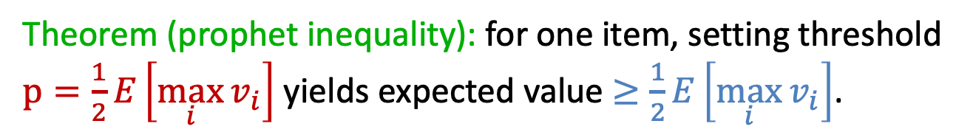
Prophet Inequality: Proof
Theorem (prophet inequality): for one item, setting threshold $p=\frac{1}{2}E\left[\max_{i}{v_{i}}\right]$ yields expected value $≥\frac{1}{2}E\left[\max_{i}{v_{i}}\right]$.
What can go wrong?
If threshold is
Too low: we might accept a small prize, preventing us from taking a larger prize in a later round.
Too high: we don’t accept any prize.

Slide 16

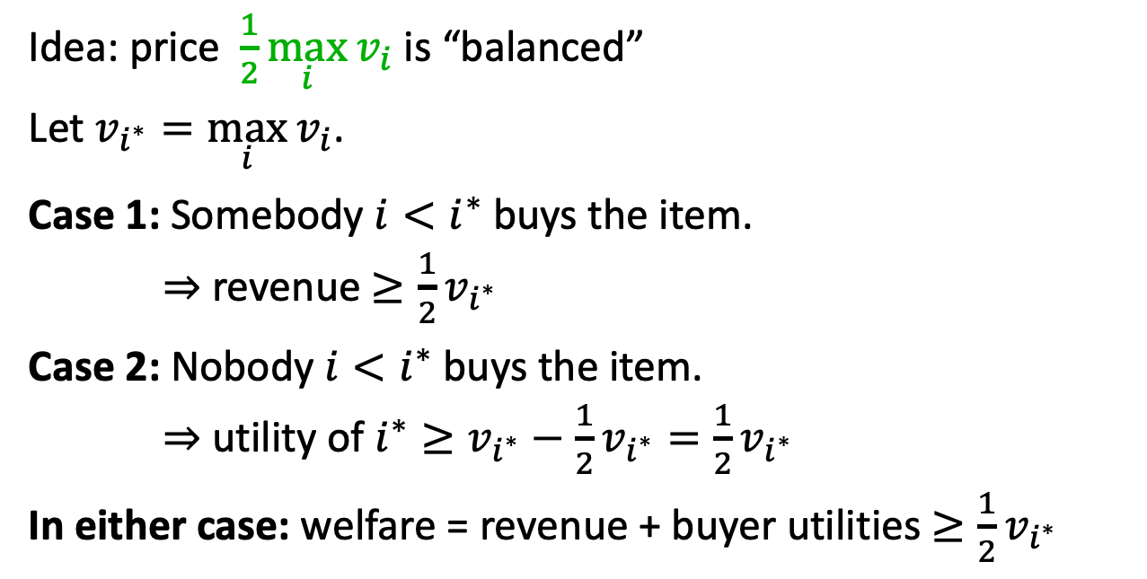



A Proof for Full Information
$$v_{1}=10$$
$$v_{2}=50$$
$$v_{3}=80$$
$$v_{4}=15$$
Idea: price $\frac{1}{2}\max_{i}{v_{i}}$ is “balanced”
Let $v_{i^{∗}}=\max_{i}{v_{i}}$.
Case 1: Somebody $i<i^{∗}$ buys the item.
$⇒$revenue $≥\frac{1}{2}v_{i^{∗}}$
Case 2: Nobody $i<i^{∗}$ buys the item.
$⇒$ utility of $i^{∗}≥v_{i^{∗}}−\frac{1}{2}v_{i^{∗}}=\frac{1}{2}v_{i^{∗}}$
In either case: welfare = revenue + buyer utilities $≥\frac{1}{2}v_{i^{∗}}$
Notes:
Again, this price of 40 is not optimal (80 is better). But we present this argument because it extends directly to the probabilistic case on the next slide

Slide 17
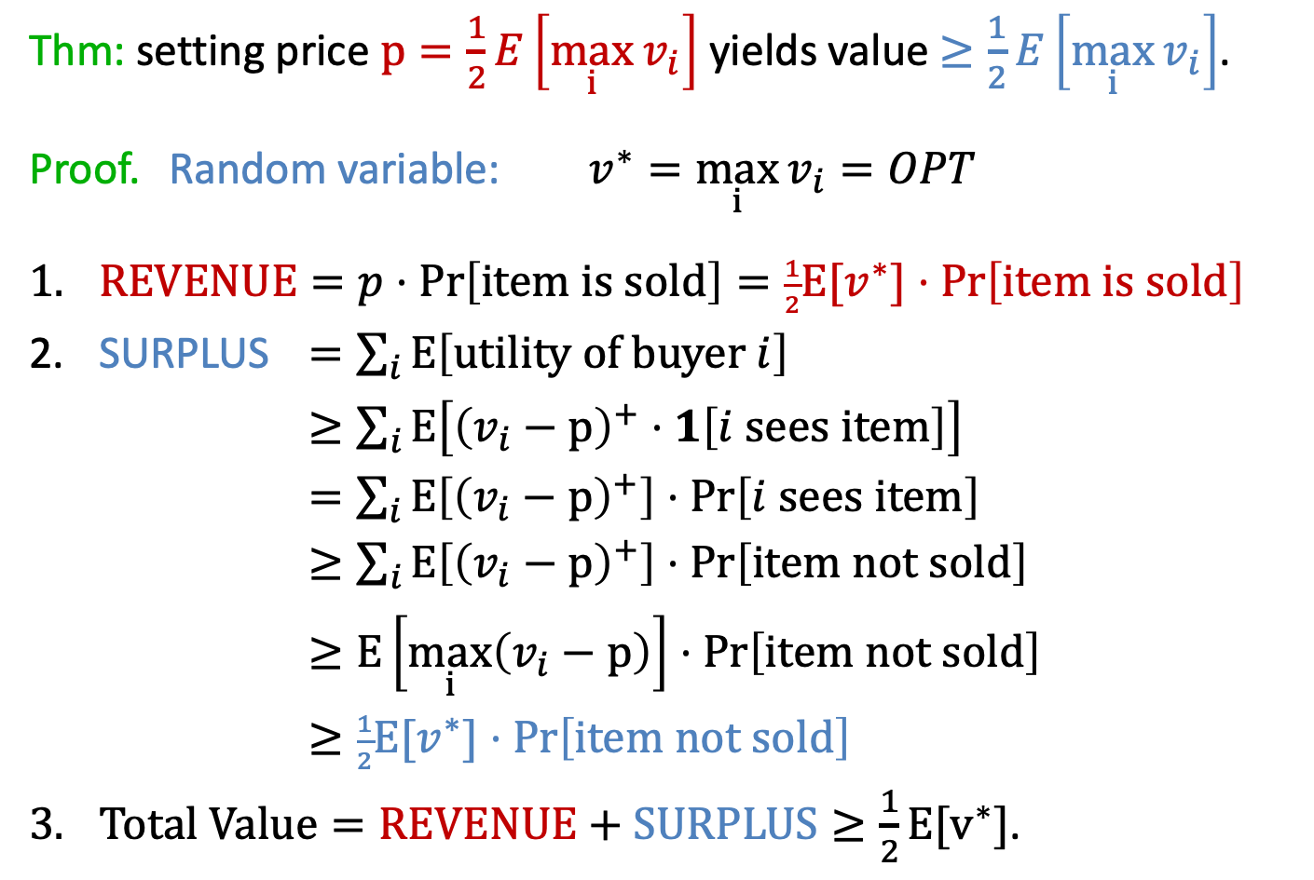
Extending to Stochastic Setting
Thm: setting price $p=\frac{1}{2}E\left[\max_{i}{v_{i}}\right]$ yields value $≥\frac{1}{2}E\left[\max_{i}{v_{i}}\right]$.
Proof. Random variable: $v^{∗}=\max_{i}{v_{i}}=OPT$
$REVENUE=p⋅\operatorname{Pr}\left[\text{item} \text{is} \text{sold}\right]=\frac{1}{2}E[v^{∗}]⋅\operatorname{Pr}\left[\text{i}\text{tem} \text{is} \text{sold}\right]$
SURPLUS $=\sum_{i}{E\left[\text{utility} \text{of} \text{buyer} i\right]}$
$≥\sum_{i}{E\left[{\left(v_{i}−p\right)}^{+}⋅1\left[i \text{sees} \text{item}\right]\right]}$
$=\sum_{i}{E\left[{\left(v_{i}−p\right)}^{+}\right]⋅Pr\left[i \text{sees} \text{item}\right]}$
$≥\sum_{i}{E\left[{\left(v_{i}−p\right)}^{+}\right]⋅Pr\left[\text{item} \text{not} \text{sold}\right]}$
$≥E\left[\max_{i}\left(v_{i}−p\right)\right]⋅Pr\left[\text{item} \text{not} \text{sold}\right]$
$≥\frac{1}{2}E[v^{∗}]⋅Pr\left[\text{ite}\text{m} \text{not} \text{sold}\right]$
$Total Value=REVENUE+SURPLUS≥\frac{1}{2}E[v^{∗}]$.
Notes:
Important: linearity of expectation trick.
-> Idea: if prob of not selling is high, then prob. that max-valued player can buy is high. Since expected value of max-valued player is high, and price is low, surplus must be high!
[ equality: independence, and doesn’t depend on value. Next line: dominance. Then just take the sum. ]
Note: x^+ == max{x, 0}

Slide 18

Prophet Inequality: Proof
Thm: for one item, price $p=\frac{1}{2}E\left[OPT\right]$ yields value $≥\frac{1}{2}E\left[OPT\right]$.
Summary:
Price is high enough that expected revenue offsets the
opportunity cost of selling the item.
Price is low enough that expected buyer surplus offsets the value left on the table due to the item going unsold.

Slide 19
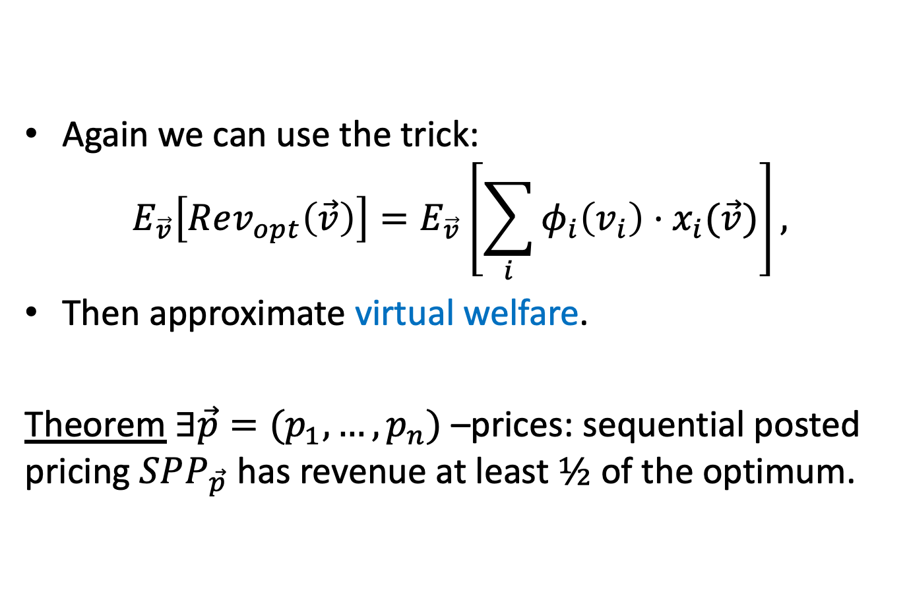
Revenue?
Again we can use the trick:
$$E_{\vec{v}}\left[Rev_{opt}\left(\vec{v}\right)\right]=E_{\vec{v}}\left[\sum_{i}{φ_{i}\left(v_{i}\right)⋅x_{i}(\vec{v})}\right],$$
Then approximate virtual welfare.
Theorem $∃\vec{p}=(p_{1},…,p_{n})$ –prices: sequential posted pricing $SPP_{\vec{p}}$ has revenue at least $½$ of the optimum.

Slide 20
Вопросы?

