Slide 1

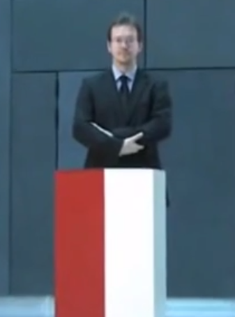
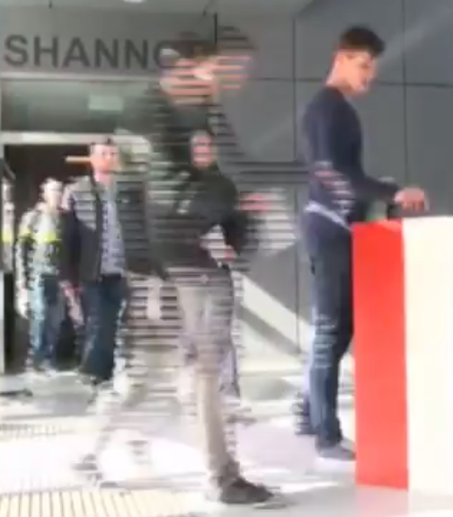
Computational Social Choice
(Part I: Overview and Classic Results)
Piotr Faliszewski
AGH University
Kraków, Poland
faliszew@agh.edu.pl
Computer Science Club
St. Petersburg 2018

Slide 2


U. Endriss (Ed.), Trends in Computatinal Social Choice, 2017
F. Brandt, V. Conitzer, U. Endriss, J. Lang, A. Procaccia (Eds.), Handbook of Computational Social Choice, 2016
P. Faliszewski, A. Procaccia, AI’s War on Manipulation: Are We Winning?, AI Magazine, 2010
Y. Chevaleyre, U. Endriss, J. Lang, N. Maudet, A Short Introduction to Computational Social Choice, SOFSEM-2007.
[…]
Computational Social Choice
10/19 ☺
Collective Decision Making
Voting
Cooperative Games
Judgment Aggregation
Matching Under Preferences
Fair Allocation

Slide 3
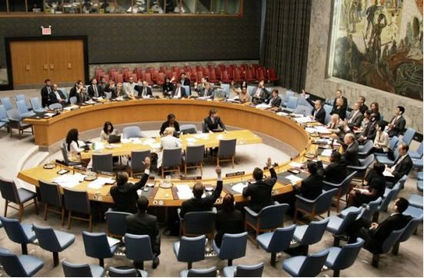

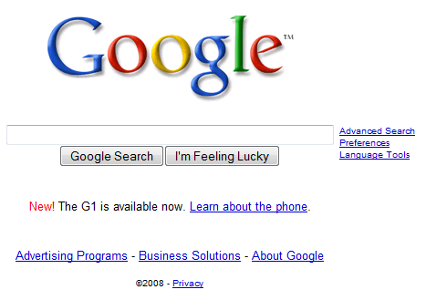

Why Are Elections Important?
  Politics
    Electing leaders
    Deciding policies, laws
    …
  Business settings
    Stock holders make decisions in companies
    University Senates, hiring decisions
    Competitions (e.g., racing, Eurovision)
  Multiagent systems
    Meta-search engines
    Planning
    Recommendation systems
    Genetic algorithms
    …
Elections aggregate the opinions of the voters

Slide 4
Computational Social Choice
(voting)
election formalism
(single winner)
ordinal
approval-based

Slide 5

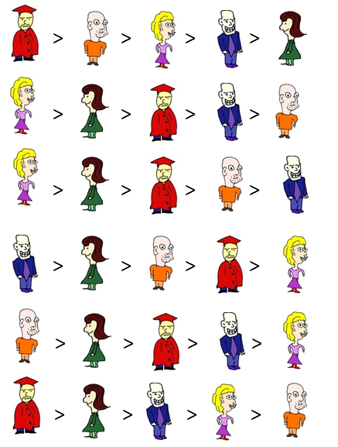
Formal Setting
Elections
E = (C, V)
f – voting rule
f( E ) = W – tied winners
C = { , , , , }
V = (v₁, … , v₆)
V₁:
V₂:
V₃:
V₄:
V₅:
V₆:

Slide 6


Formal Setting
Elections
E = (C, V)
f – voting rule
f( E ) = W – tied winners
Examples of voting rules:
Plurality
C = { , , , , }
V = (v₁, … , v₆)
1 0 0 0 0
V₁:
V₂:
V₃:
V₄:
V₅:
V₆:

Slide 7

Formal Setting
Elections
E = (C, V)
f – voting rule
f( E ) = W – tied winners
Examples of voting rules:
Plurality
Borda
C = { , , , , }
V = (v₁, … , v₆)
4 3 2 1 0
V₁:
V₂:
V₃:
V₄:
V₅:
V₆:

Slide 8
Formal Setting
Elections
E = (C, V)
f – voting rule
f( E ) = W – tied winners
Examples of voting rules:
Plurality
Borda
k-Approval
C = { , , , , }
V = (v₁, … , v₆)
1 1 0 0 0
V₁:
V₂:
V₃:
V₄:
V₅:
V₆:

Slide 9
Formal Setting
Elections
E = (C, V)
f – voting rule
f( E ) = W – tied winners
Examples of voting rules:
Plurality
Borda
k-Approval
Veto
C = { , , , , }
V = (v₁, … , v₆)
1 1 1 1 0
V₁:
V₂:
V₃:
V₄:
V₅:
V₆:

Slide 10


Formal Setting
Elections
E = (C, V)
f – voting rule
f( E ) = W – tied winners
Condorcet winner and majority graph:
C = { , , , , }
V = (v₁, … , v₆)
V₁:
V₂:
V₃:
V₄:
V₅:
V₆:

Slide 11
Formal Setting
Elections
E = (C, V)
f – voting rule
f( E ) = W – tied winners
Copeland Rule
C = { , , , , }
V = (v₁, … , v₆)
V₁:
3
4
V₂:
0.5
V₃:
V₄:
V₅:
V₆:
0.5
1

Slide 12
Formal Setting
Elections
E = (C, V)
f – voting rule
f( E ) = W – tied winners
Examples of voting rules:
Plurality
Borda
k-Approval
Veto
Copeland
Dodgson
Kemeny
C = { , , , , }
V = (v₁, … , v₆)
V₁:
V₂:
V₃:
V₄:
V₅:
V₆:

Slide 13
Formal Setting
Elections
E = (C, V)
f – voting rule
f( E ) = W – tied winners
Examples of voting rules:
Plurality
Borda
k-Approval
Veto
Copeland
Dodgson
Kemeny
STV
…
C = { , , , , }
V = (v₁, … , v₆)
V₁:
V₂:
STV: Eliminate whoever has lowest plurality score, until someone has majority support
V₃:
V₄:
V₅:
V₆:

Slide 14
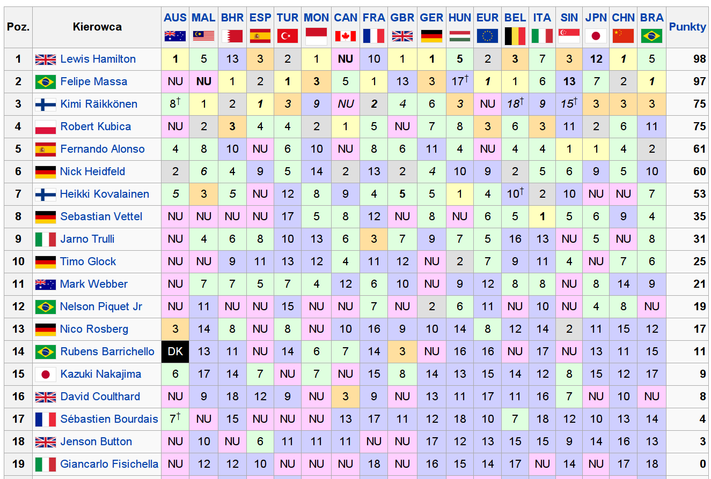
Formula 1: Season 2008
Drivers receive points: 10, 8, 6, 5, 4, 3, 2, 1

Slide 15
Formula 1: Other Voting Rules
 | Official | Borda | Plurality | 2-appr | 3-appr | 4-appr | Copeland | Maximin | STV
Lewis Hamilton | 1 | 1 | 2 | 2 | 1 | 1 | 2 | 1 | 2
Felipe Massa | 2 | 3 | 1 | 1 | 1 | 1 | 1 | 9 | 1
Kimi Räikkonen | 3 | 5 | 3 | 3 | 3 | 1 | 3 | 1 | 3
Robert Kubica | 4 | 2 | 5 | 3 | 4 | 4 | 4 | 1 | 5
Fernando Alonso | 5 | 6 | 3 | 6 | 6 | 5 | 7 | 5 | 3
Nick Heidfeld | 6 | 4 | 8 | 3 | 5 | 6 | 5 | 1
Heikki Kovalainen | 7 | 7 | 5 | 7 | 6 | 7 | 6 | 5 | 5
Sebastian Vettel | 8 | 12 | 5 | 8 | 9 | 9 | 12 | 17 | 5
Jarno Trulli | 9 | 8 | 8 | 12 | 9 | 9 | 8 | 5
Timo Glock | 10 | 10 | 8 | 8 | 9 | 8 | 9 | 5

Slide 16
Formula 1: Other Voting Rules
 | Oficjalny | Borda | Plurality | 2-appr | 3-appr | 4-appr | Copeland | Maximin | STV
Lewis Hamilton | 1 | 1 | 2 | 2 | 1 | 1 | 2 | 1 | 2
Felipe Massa | 2 | 3 | 1 | 1 | 1 | 1 | 1 | 9 | 1
Kimi Räikkonen | 3 | 5 | 3 | 3 | 3 | 1 | 3 | 1 | 3
Robert Kubica | 4 | 2 | 5 | 3 | 4 | 4 | 4 | 1 | 5
Fernando Alonso | 5 | 6 | 3 | 6 | 6 | 5 | 7 | 5 | 3
Nick Heidfeld | 6 | 4 | 8 | 3 | 5 | 6 | 5 | 1
Heikki Kovalainen | 7 | 7 | 5 | 7 | 6 | 7 | 6 | 5 | 5
Sebastian Vettel | 8 | 12 | 5 | 8 | 9 | 9 | 12 | 17 | 5
Jarno Trulli | 9 | 8 | 8 | 12 | 9 | 9 | 8 | 5
Timo Glock | 10 | 10 | 8 | 8 | 9 | 8 | 9 | 5
Arrow’s Theorem (intuition)
There is no perfect, always fair, voting rule
Conclusions
Voting rules are designed and used for specific purposes
(but they will always have flaws)

Slide 17
Computational Social Choice
(voting)
Plurality
Borda
committee
elections
t-Approval
scoring rules
Bucklin
other ideas
(iterative etc.)
election formalism
(single winner)
STV
ordinal
Copeland
approval-based
Maximin
Condorcet rules
(graphs!)
Dodgson

Slide 18

winner determination
problem families
Computational Social Choice
(voting)
Plurality
Borda
t-Approval
scoring rules
Bucklin
other ideas
(iterative etc.)
election formalism
(single winner)
STV
ordinal
Copeland
approval-based
Maximin
Condorcet rules
(graphs!)
Dodgson

Slide 19

winner determination
problem families
Computational Social Choice
(voting)
Plurality
Borda
t-Approval
scoring rules
Bucklin
other ideas
(iterative etc.)
election formalism
(single winner)
STV
ordinal
Copeland
approval-based
Maximin
Condorcet rules
(graphs!)
Dodgson

Slide 20
A Primer on Computational Complexity Theory

Slide 21

Computationally Hard Problems
What does it mean that a problem is computationally hard?
No polynomial time algorithm!
Can we prove that such problems exist?
  Yes…
  … but it’s useless in most cases
A different computational
complexity class…

Slide 22
Compexity Class NP
Complexity class NP (nondeterministic polynomial-time): The class of decision problems for which there are polynomial-time, nondeterministic algorithms.
What is a nondeterministic computation?

Slide 23
(Non)deterministic Computation
Deterministic computation
Nondeterministic computation
x
x
no
no
Yes / No
no
yes
no

Slide 24
(Non)deterministic Computation
Deterministic computation
Nondeterministic computation
x
x
poly(|x|)
poly(|x|)
no
no
Yes / No
no
yes
no

Slide 25
What does it all mean?
Nondeterministic computation
Just like normal computation …
… but the algorithm can make guesses
3
1
SetCover
Input: S = {S₁, … S_{m}} – family of sets
k – an integer
Question: Is there a family of k sets from S whose union is equal to union of all sets from S?
4
6
2
5

Slide 26
What does it all mean?
Nondeterministic computation
Just like normal computation …
… but the algorithm can make guesses
3
1
SetCover
Input: S = {S₁, … S_{m}} – family of sets
k – an integer
Question: Is there a family of k sets from S whose union is equal to union of all sets from S?
4
6
2
5

Slide 27
Compexity Class NP
Complexity class NP (nondeterministic polynomial-time): The class of decision problems for which there are polynomial-time , nondeterministic algorithms.
Class NP: Class of problems whose solutions can be verified in polynomial time.

Slide 28
Is NP bigger than P? – that is the question!
Clearly, all problems from P also belong to NP. What about the other way round?
One of the biggest questions in …
well... all of science ☺
NP
P
If we do not know if NP is bigger, how can it help us? There is an order on the hardness of problems!

Slide 29
Partial Order of Hardness
If A reduces to B, then A is no harder than B ➔ If we could solve B, we could solve A as well.
Reductions between problems
A, B – two decision problems
A reduces to B if there is a polynomial-time computable function f such that
x in A ⬄ f(x) in B
f
NP-complete problem: All problems in NP reduce to it.
A
B
f

Slide 30
winner determination
problem families
Computational Social Choice
(voting)
Plurality
Borda
t-Approval
scoring rules
Bucklin
other ideas
(iterative etc.)
election formalism
(single winner)
STV
ordinal
Copeland
approval-based
Maximin
Condorcet rules
(graphs!)
Dodgson

Slide 31


Dodgson Score
V₁:
Dodgson Score of candidate c: Smallest numer of swaps of adjacent candidates that ensures that cancidate c is a Condorcet winner
V₂:
V₃:
V₄:
V₅:
V₆:
Dodgson score of is 0 (she is a Dodgson winner)
Dodgson score of ?

Slide 32
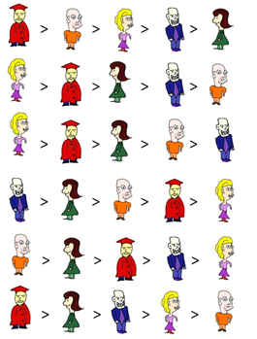
Dodgson Score
V₁:
Dodgson Score of candidate c: Smallest numer of swaps of adjacent candidates that ensures that cancidate c is a Condorcet winner
V₂:
V₃:
V₄:
V₅:
V₆:
J. Bartholdi, C. Tovey, M. Trick, Voting Schemes for which It Can Be Difficult
to Tell Who Won the Election, Social Choice and Welfare, 1989
L. Hemaspaandra, E. Hemaspaandra, J. Rothe, Exact Analysis of Dodgson Elections: Lewis Carroll's 1876 Voting System is Complete for Parallel Access to NP., J. ACM, 1997
N. Betzler, J. Guo, R. Niedermeier, Parameterized computational complexity of Dodgson and Young elections, Information and Computation, 2010
M. Fellows, B. Jansen, D. Lokshtanov, F. Rosamond, S. Saurabh, Determining the Winner of a Dodgson Election is Hard, FSTTCS 2010
I.Caragiannis, J. Covey, M.Feldman, C. Homan, C. Kaklamanis, N. Karanikolas, A. Procaccia, J. Rosenschein, On the approximability of Dodgson and Young elections, Artificial Intelligence, 2012
[….]
Dodgson score of is 0 (she is a Dodgson winner)
Dodgson score of is 2

Slide 33
Dodgson Score is NP-Complete
Reduction from X3C
Election
C = {1,2, …, 3k, 1’, 2’, … 3k’, S₁, …, S_{n}, p}
X3C votes:
1 > 3 > 4 > S₁ > p > …
1 > 3 > 6 > S₂ > p > …
2 > 4 > 5 > S₃ > p > …
…
3
1
Equalizing votes:
1 > 1’ > p > …
1 > 1’ > p > …
4 > 4’ > p > …
…
4
6
2
5
ensure that every set element is preferred to p in the same numer of votes

Slide 34
Dodgson Score is NP-Complete
Reduction from X3C
Election
C = {1,2, …, 3k, 1’, 2’, … 3k’, S₁, …, S_{n}, p}
X3C votes:
1 > 3 > 4 > S₁ > p > …
1 > 3 > 6 > S₂ > p > …
2 > 4 > 5 > S₃ > p > …
…
3
1
Equalizing votes:
1 > 1’ > p > …
1 > 1’ > p > …
4 > 4’ > p > …
…
4
6
2
5
Defeating votes:
1 > 2 > … > 3k > 1’ > 2’ > … > 3k’ > p > …
1 > 2 > … > 3k > 1’ > 2’ > … > 3k’ > p > …
1 > 2 > … > 3k > 1’ > 2’ > … > 3k’ > p > …
…
enough to ensure that for each set element i we have
N_{E}(i,p) – N_{E}(p,i) = 1

Slide 35
Dodgson Score is NP-Complete
Reduction from X3C
Election
C = {1,2, …, 3k, 1’, 2’, … 3k’, S₁, …, S_{n}, p}
X3C votes:
1 > 3 > 4 > S₁ > p > …
1 > 3 > 6 > S₂ > p > …
2 > 4 > 5 > S₃ > p > …
…
3
1
Equalizing votes:
1 > 1’ > p > …
1 > 1’ > p > …
4 > 4’ > p > …
…
4
6
2
5
Defeating votes:
1 > 2 > … > 3k > 1’ > 2’ > … > 3k’ > p > …
1 > 2 > … > 3k > 1’ > 2’ > … > 3k’ > p > …
1 > 2 > … > 3k > 1’ > 2’ > … > 3k’ > p > …
…
p defeats everyone except for the set elements
p has Dodgson score 4k if and only if there is an exact cover

Slide 36
winner determination
possible and necessary winners
winner prediction
margin of victory
problem families
changing
the result
Computational Social Choice
(voting)
Plurality
Borda
t-Approval
scoring rules
Bucklin
other ideas
(iterative etc.)
election formalism
(single winner)
STV
ordinal
Copeland
approval-based
Maximin
Condorcet rules
(graphs!)
Dodgson

Slide 37
Puzzle: Who Wins?
Voting for an operating system to use in the lab.
Rule: Borda
Linux : 21
Windows : 20
Mac : 5
Votes:
7: Linux > Windows > Mac
6: Windows > Linux > Mac
2: Mac > Windows > Linux
1: Mac > Linux > Windows
Puzzle: Why would Mac win this election? ☺

Slide 38
Can we avoid strategic voting?
Nondictatorship
  There is no voter v_{i} such that f(v_{i}) = top(v_{i})
Unrestricted domain
  Every vote is legal (i.e., every linear order can be cast as a vote, we can have as many candidates as we like)
Unanimity
  If all voters rank c first, then f(V) = c
Gibbard-Satterthwaite Theorem: Consider a set C of at least three candidates. Dictatorship is the only social choice function
f: L(C)^{n} → C
that accepts unrestricted domain, is unanimous, and reporting truthful preferences is the dominant strategy for the voters.

Slide 39
Gibbard-Satterthwaite Theorem
Gibbard--Satterthwaite Theorem: Consider a set C of at least 3 candidates. Dictatorship is the only social choice function
f: L(C)^{n} → C that accepts unrestricted domains, is unanimous, and reporting truthful preferences is the dominant strategy for the votgers.
History of the proofs
1973 – Gibbard
1975 – Satterthwaite
1978 – Schmeider/Sonnenschein
1983 – Barbera
1990 – Barbera/Peleg
2000 – Benoit
2001 – Sen
2001 – Remy
2009 – Cato
2012 – Ninjbat

Slide 40
Gibbard-Satterthwaite Theorem
Gibbard--Satterthwaite Theorem: Consider a set C of at least 3 candidates. Dictatorship is the only social choice function
f: L(C)^{n} → C that accepts unrestricted domains, is unanimous, and reporting truthful preferences is the dominant strategy for the votgers.
History of the proofs
1973 – Gibbard
1975 – Satterthwaite
1978 – Schmeider/Sonnenschein
1983 – Barbera
1990 – Barbera/Peleg
2000 – Benoit
2001 – Sen
2001 – Remy
2009 – Cato
2012 – Ninjbat

Slide 41
Proof of the G-S Theorem: Start
C = {a, b, c, …} – set of at least 3 candidates
f: L(C)^{n} → C – social choice function
(unanimous, nonmanipulable)
v₁: a > b > c > …
v₂: a > c > b > …
…
v_{n}: b > c > a > …
V
Lemma (shifting): If f(V) = a and we form V’ by shifting b forward by one position in some vote, then f(V’) ∈ {a, b}
v₁: a > b > c > …
v₂: a > b > c > …
…
v_{n}: b > c > a > …
V’
Proof
If f( V’ ) = c (c ≠ a, c ≠ b) then
v₂: a > c – v₂ would prefer to lie in V’
v₂: c > a – v₂ would prefer to lie in V

Slide 42
Proof of the G-S Theorem: Step 1
v₁: > ... > … > b
v₂: > ... > … > b
…
v_{n}: > ... > … > b
f(V₀) ≠ b
V₀
What if f(V₀) = b?
v₁: > ... > … > b
v₂: > ... > … > b
…
v_{t-1}: > ... > … > b
v_{t}: > ... > … > b
…
v_{n}: > ... > … > b
f(V’₀) = b
V’₀

Slide 43
Proof of the G-S Theorem: Step 1
v₁: > ... > … > b
v₂: > ... > … > b
…
v_{n}: > ... > … > b
f(V₀) ≠ b
V₀
What if f(V₀) = b?
v₁: a > ... > … > b
v₂: > ... > … > b
…
v_{t-1}: > ... > … > b
v_{t}: > ... > … > b
…
v_{n}: > ... > … > b
f(V’₀) = b
V’₀

Slide 44
Proof of the G-S Theorem: Step 1
v₁: > ... > … > b
v₂: > ... > … > b
…
v_{n}: > ... > … > b
f(V₀) ≠ b
V₀
What if f(V₀) = b?
v₁: a > ... > … > b
v₂: a > ... > … > b
…
v_{t-1}: > ... > … > b
v_{t}: > ... > … > b
…
v_{n}: > ... > … > b
f(V’₀) = b
V’₀

Slide 45
Proof of the G-S Theorem: Step 1
v₁: > ... > … > b
v₂: > ... > … > b
…
v_{n}: > ... > … > b
f(V₀) ≠ b
V₀
What if f(V₀) = b?
v₁: a > ... > … > b
v₂: a > ... > … > b
…
v_{t-1}: a > ... > … > b
v_{t}: > ... > … > b
…
v_{n}: > ... > … > b
f(V’₀) = b
V’₀

Slide 46
Proof of the G-S Theorem: Step 1
v₁: > ... > … > b
v₂: > ... > … > b
…
v_{n}: > ... > … > b
f(V₀) ≠ b
V₀
What if f(V₀) = b?
v₁: a > ... > … > b
v₂: a > ... > … > b
…
v_{t-1}: a > ... > … > b
v_{t}: a > ... > … > b
…
v_{n}: > ... > … > b
f(V’₀) = a
V’₀
A step before, v_{t} also preferred a to b, so v_{t} would have preferred to lie then
This had to happen due to unanimity

Slide 47
Proof of the G-S Theorem: Step 1
v₁: > ... > … > b
v₂: > ... > … > b
…
v_{n}: > ... > … > b
f(V₀) ≠ b
V₀
shift b to the top position as long as it does not become a winner
v₁: b > ... > …
v₂: b > ... > …
…
v_{r-1}: b > ... > …
v_{r}: k > ... > … > b
V_{r+1}: a₁ > ... > … > b
…
v_{n}: a_{whatever}> … > b
V₁
f(V₁) ≠ b

Slide 48
Proof of the G-S Theorem: Step 1
v₁: > ... > … > b
v₂: > ... > … > b
…
v_{n}: > ... > … > b
f(V₀) ≠ b
V₀
shift b to the top position as long as it does not become a winner
v₁: b > ... > …
v₂: b > ... > …
…
v_{r-1}: b > ... > …
v_{r}: k > ... > … > b
V_{r+1}: a₁ > ... > … > b
…
v_{n}: a_{whatever}> … > b
v₁: b > ... > …
v₂: b > ... > …
…
v_{r-1}: b > ... > …
v_{r}: b > k > … > …
V_{r+1}: a₁ > ... > … > b
…
v_{n}: a_{whatever}> … > b
V₁
V₂
shift b in v_{r}
f(V₁) ≠ b
f(V₂) = b

Slide 49
Proof of the G-S Theorem: Step 1
If v_{i} with i > r changes a vote to another one, then b is still winning
(otherwise, this voter would lie in V₂)
v₁: > ... > … > b
v₂: > ... > … > b
…
v_{n}: > ... > … > b
V₀
v₁: b > ... > …
v₂: b > ... > …
…
v_{r-1}: b > ... > …
v_{r}: k > ... > … > b
V_{r+1}: a₁ > ... > … > b
…
v_{n}: a_{whatever}> … > b
v₁: b > ... > …
v₂: b > ... > …
…
v_{r-1}: b > ... > …
v_{r}: b > k > … > …
V_{r+1}: a₁ > ... > … > b
…
v_{n}: a_{whatever}> … > b
V₁
V₂
f(V₁) ≠ b
f(V₂) = b

Slide 50
Proof of the G-S Theorem: Step 1
If v_{i} with i > r changes a vote to another one, then b is still winning
(otherwise, this voter would lie in V₂)
v₁: > ... > … > b
v₂: > ... > … > b
…
v_{n}: > ... > … > b
V₀
If v_{i} with i < r changes a vote to another one, where b is first, b still is winning
(otherwise, this voter would lie in the new profile)
v₁: b > ... > …
v₂: b > ... > …
…
v_{r-1}: b > ... > …
v_{r}: k > ... > … > b
V_{r+1}: a₁ > ... > … > b
…
v_{n}: a_{whatever}> … > b
v₁: b > ... > …
v₂: b > ... > …
…
v_{r-1}: b > ... > …
v_{r}: b > k > … > …
V_{r+1}: a₁ > ... > … > b
…
v_{n}: a_{whatever}> … > b
V₁
V₂
f(V₁) ≠ b
f(V₂) = b

Slide 51
Proof of the G-S Theorem: Step 1
Conclusion
If v₁ … v_{r} rank b first, then b is winning
If v_{r} … v_{n} rank b last, then b is losing
v₁: > ... > … > b
v₂: > ... > … > b
…
v_{n}: > ... > … > b
V₀
v₁: b > ... > …
v₂: b > ... > …
…
v_{r-1}: b > ... > …
v_{r}: k > ... > … > b
V_{r+1}: a₁ > ... > … > b
…
v_{n}: a_{whatever}> … > b
v₁: b > ... > …
v₂: b > ... > …
…
v_{r-1}: b > ... > …
v_{r}: b > k > … > …
V_{r+1}: a₁ > ... > … > b
…
v_{n}: a_{whatever}> … > b
V₁
V₂
f(V₁) ≠ b
f(V₂) = b

Slide 52
Proof of the G-S Theorem: Step 2
If v₁ … v_{r} rank b first, then b is winning
If v_{r} … v_{n} rank b last, then b is losing
We want to show f(V₃) = k
f(V₄) = k
shift b to the top in v₁ … v_{r-1}
v₁: > ... > … > b
v₂: > ... > … > b
…
v_{r-1}: > ... > … > b
v_{r}: k > ... > … > b
V_{r+1}: > ... > … > b
…
v_{n}: > ... > … > b
v₁: b > k > … > …
v₂: b > k > … > …
…
v_{r-1}: b > k > … > …
v_{r}: k > ... > … > b
v_{r+1}: k > ... > … > b
…
v_{n}: k > ... > … > b
f(V_{3’}) = k
V₃
V₄
v₁: k > ... > … > b
v₂: k > ... > … > b
…
v_{r-1}: k > ... > … > b
v_{r}: k > ... > … > b
V_{r+1}: k > ... > … > b
…
v_{n}: k > ... > … > b
V_{3’}
shift k to the top position everywhere
unanimity

Slide 53
Proof of the G-S Theorem: Step 2
If v₁ … v_{r} rank b first, then b is winning
If v_{r} … v_{n} rank b last, then b is losing
We want to show f(V₃) = k
f(V₄) = k
f(V₅) = k
v₁: > ... > … > b
v₂: > ... > … > b
…
v_{r-1}: > ... > … > b
v_{r}: k > ... > … > b
V_{r+1}: > ... > … > b
…
v_{n}: > ... > … > b
v₁: b > k > … > …
v₂: b > k > … > …
…
v_{r-1}: b > k > … > …
v_{r}: k > ... > … > b
v_{r+1}: k > ... > … > b
…
v_{n}: k > ... > … > b
v₁: b > k > … > …
v₂: b > k > … > …
…
v_{r-1}: b > k > … > …
v_{r}: k > b > … > …
v_{r+1}: k > ... > … > b
…
v_{n}: k > ... > … > b
V₃
V₄
V₅
Shift b – no winner change or v_{r} would want to lie

Slide 54
Proof of the G-S Theorem: Step 2
If v₁ … v_{r} rank b first, then b is winning
If v_{r} … v_{n} rank b last, then b is losing
Assume f(V₃) = g, g ≠ k
f(V₄) = k
f(V₅) = k
v₁: > ... > … > b
v₂: > ... > … > b
…
v_{r-1}: > ... > … > b
v_{r}: k > ... > … > b
V_{r+1}: > ... > … > b
…
v_{n}: > ... > … > b
v₁: b > k > … > …
v₂: b > k > … > …
…
v_{r-1}: b > k > … > …
v_{r}: k > ... > … > b
v_{r+1}: k > ... > … > b
…
v_{n}: k > ... > … > b
v₁: b > k > … > …
v₂: b > k > … > …
…
v_{r-1}: b > k > … > …
v_{r}: k > b > … > …
v_{r+1}: k > ... > … > b
…
v_{n}: k > ... > … > b
V₃
V₄
V₅
Shift b – no winner change or v_{r} would want to lie

Slide 55
Proof of the G-S Theorem: Step 2
If v₁ … v_{r} rank b first, then b is winning
If v_{r} … v_{n} rank b last, then b is losing
Assume f(V₃) = g, g ≠ k
By shifting lemma
f(V₆) ∈ {b, g}
If g were winning in V₆, then v_{r} could shift b to top, and b would win
v_{r} prefers b to g (or b = g)
f(V₅) = k
v₁: > ... > … > b
v₂: > ... > … > b
…
v_{r-1}: > ... > … > b
v_{r}: k > ... > … > b
V_{r+1}: > ... > … > b
…
v_{n}: > ... > … > b
v₁: b > k > … > …
v₂: b > k > … > …
…
v_{r-1}: b > k > … > …
v_{r}: k > b > … > …
v_{r+1}: k > ... > … > b
…
v_{n}: k > ... > … > b
V₃
V₅
v₁: b > ... > …
v₂: b > ... > …
…
v_{r-1}: b > ... > …
v_{r}: k > b > …
V_{r+1}: > ... > … > b
…
v_{n}: > ... > … > b
V₆
shift b to top in v₁ … v_{r-1}
and second to last in v_{r}

Slide 56
Proof of the G-S Theorem: Step 2
If v₁ … v_{r} rank b first, then b is winning
If v_{r} … v_{n} rank b last, then b is losing
3) So… b = f(V₅) = k
contradiction!
Assume f(V₃) = g, g ≠ k
f(V₅) = k
v₁: > ... > … > b
v₂: > ... > … > b
…
v_{r-1}: > ... > … > b
v_{r}: k > ... > … > b
V_{r+1}: > ... > … > b
…
v_{n}: > ... > … > b
2) shifting k in v_{r+1} … v_{n} cannot change the result from b
v₁: b > k > … > …
v₂: b > k > … > …
…
v_{r-1}: b > k > … > …
v_{r}: k > b > … > …
v_{r+1}: k > ... > … > b
…
v_{n}: k > ... > … > b
1) shifting k in v₁ … v_{r-1} cannot change the result from b
V₃
V₅
f(V₆) = b
v₁: b > ... > …
v₂: b > ... > …
…
v_{r-1}: b > ... > …
v_{r}: k > b > …
V_{r+1}: > ... > … > b
…
v_{n}: > ... > … > b
V₆
shift b to top in v₁ … v_{r-1}
and second to last in v_{r}
shift k to 2nd best in v₁ … v_{r-1}
shift k to top in v_{r+1} … v_{n}

Slide 57
Proof of the G-S Theorem: Step 3
If v₁ … v_{r} rank b first, then b is winning
If v_{r} … v_{n} rank b last, then b is losing
v₁: > ... > …
v₂: > ... > …
…
v_{r-1}: > ... > …
v_{r}: k > ... > …
V_{r+1}: > ... > …
…
v_{n}: > ... > …
v₁: > ... > … > b
v₂: > ... > … > b
…
v_{r-1}: > ... > … > b
v_{r}: k > ... > … > b
V_{r+1}: > ... > … > b
…
v_{n}: > ... > … > b
If v₁ … v_{n} rank b last, but v_{r} ranks k first, k wins
Proof is complete!
V₇
V₈
v₁: b > ... > c
v₂: b > ... > c
…
v_{r-1}: b > ... > c
v_{r}: b > … > c
V_{r+1}: a > ... > c
…
v_{n}: a > … > c
shift b
back
V₉
f(V₇) ∈{k, b}
(by shifting lemma)
f(V₈) = k
(by step 2)
If k = b then we’re good!
If k ≠ b then… rerun the whole
proof for c in the place of b
We discover pivotal voter v_{m} for c.
b must win in V₉ (step 1)
Top choice of v_{m} must win in V₉
Thus m ≤ r
Symmetrically, r ≤ m
f(V₇) ∈{k, c}

Slide 58
winner determination
possible and necessary winners
winner prediction
margin of victory
problem families
campaign management
bribery
control
changing
the result
strategic voting (manipulation)
Computational Social Choice
(voting)
Plurality
Borda
t-Approval
scoring rules
Bucklin
other ideas
(iterative etc.)
election formalism
(single winner)
STV
ordinal
Copeland
approval-based
Maximin
Condorcet rules
(graphs!)
Dodgson

Slide 59
winner determination
possible and necessary winners
winner prediction
margin of victory
problem families
campaign management
bribery
control
changing
the result
strategic voting (manipulation)
Computational Social Choice
(voting)
Plurality
Borda
t-Approval
scoring rules
Bucklin
other ideas
(iterative etc.)
election formalism
(single winner)
STV
ordinal
Copeland
approval-based
Maximin
Condorcet rules
(graphs!)
Dodgson

Slide 60


Complexity Barrier Approach
Model: Represent each cheating strategy as a computational decision problem.
Complexity barrier approach: If manipulating elections is hard, then we can ignore the fact that it is in principle possible.
Approach initiated by Bartholdi, Tovey, and Trick in the late 80s and the early 90s

Slide 61
Complexity Barrier: Results
Effects of complexity barrier research
  Dozens of computational problems identified
  Multiple standard election systems analyzed
  Quite thorough understanding of worst case complexity of elections
Complications…
  We would like some of the problems to be efficiently computable
    Determining winners
    Organizing a campaign
  Worst-case analysis seems problematic…

Slide 62
winner determination
possible and necessary winners
winner prediction
margin of victory
problem families
campaign management
bribery
control
changing
the result
strategic voting (manipulation)
Computational Social Choice
(voting)
Plurality
Borda
t-Approval
scoring rules
Bucklin
other ideas
(iterative etc.)
election formalism
(single winner)
STV
ordinal
Copeland
approval-based
Maximin
Condorcet rules
(graphs!)
Dodgson

Slide 63


Manipulation
Setting
Given: E = (C,V) – election,
p – preferred cand.
Question: Is it possible to ensure p’s victory by a given action, specified in the problem?
p =
V₁:
V₂:
V₃:
Manipulation
(strategic voting)
V₄:
V₅:
V₆:

Slide 64
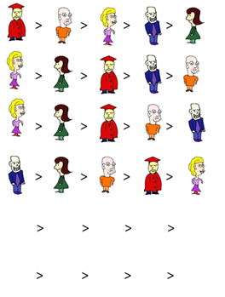
Manipulation
Setting
Given: E = (C,V) – election,
p – preferred cand.
Question: Is it possible to ensure p’s victory by a given action, specified in the problem?
p =
Gibbard-Satterthwaite Theorem
For every voting rule, there exists an election where for some voters there is an incentive to vote strategically
V₁:
V₂:
V₃:
Manipulation
(strategic voting)
V₄:
Action: Fixed voters (the manipulators) can change their votes as they like
V₅:
? ? ? ? ?
V₆:
? ? ? ? ?

Slide 65
Manipulation
Setting
Given: E = (C,V) – election,
p – preferred cand.
Question: Is it possible to ensure p’s victory by a given action, specified in the problem?
J. Bartholdi, C. Tovey, M. Trick, The computational difficulty of manipulating an election, SC&W 1989
J. Bartholid, J. Orlin, Single Transferable Vote Resists Strategic Voting, SC&W 1991
V. Conitzer, T. Sandholm, J. Lang, When are elections with few candidates hard to manipulate? J.ACM 2007
p =
Gibbard-Satterthwaite Theorem
For every voting rule, there exists an election where for some voters there is an incentive to vote strategically
V₁:
V₂:
V₃:
Manipulation
(strategic voting)
V₄:
Complexity
Barrier!
Action: Fixed voters (the manipulators) can change their votes as they like
V₅:
? ? ? ? ?
V₆:
? ? ? ? ?

Slide 66
Manipulation
Setting
Given: E = (C,V) – election,
p – preferred cand.
Question: Is it possible to ensure p’s victory by a given action, specified in the problem?
p =
V₁:
V₂:
V₃:
Manipulation
(strategic voting)
V₄:
Action: Fixed voters (the manipulators) can change their votes as they like
V₅:
? ? ? ? ?
V₆:
? ? ? ? ?

Slide 67
Bribery and Friends
Setting
Given: E = (C,V) – election,
p – preferred cand.
Question: Is it possible to ensure p’s victory by a given action, specified in the problem?
P. Faliszewski, E. Hemaspaandra,
L. Hemaspaandra, How Hard is Bribery in Elections?, JAIR 2009
$Bribery
p =
Action: Each voter has a price (possibly a unit) for changing his/her vote; we cannot exceed budget
$10
V₁:
$5
V₂:
$8
V₃:
Manipulation
(strategic voting)
$15
V₄:
Action: Fixed voters (the manipulators) can change their votes as they like
$1
V₅:
$4
V₆:

Slide 68
Bribery and Friends
Setting
Given: E = (C,V) – election,
p – preferred cand.
Question: Is it possible to ensure p’s victory by a given action, specified in the problem?
P. Faliszewski, E. Hemaspaandra,
L. Hemaspaandra, How Hard is Bribery in Elections?, JAIR 2009
Bribery
p =
Action: Each voter has a price (possibly a unit) for changing his/her vote; we cannot exceed budget
$1
V₁:
$1
V₂:
$1
V₃:
Manipulation
(strategic voting)
$1
V₄:
Action: Fixed voters (the manipulators) can change their votes as they like
$1
V₅:
$1
V₆:

Slide 69
Bribery and Friends
Setting
Given: E = (C,V) – election,
p – preferred cand.
Question: Is it possible to ensure p’s victory by a given action, specified in the problem?
$Bribery
p =
Action: Each voter has a price (possibly a unit) for changing his/her vote; we cannot exceed budget
$10
V₁:
$5
V₂:
$8
V₃:
Manipulation
(strategic voting)
$15
V₄:
Action: Fixed voters (the manipulators) can change their votes as they like
$1
V₅:
$4
V₆:

Slide 70
Bribery and Friends
Setting
Given: E = (C,V) – election,
p – preferred cand.
Question: Is it possible to ensure p’s victory by a given action, specified in the problem?
$Bribery
p =
Action: Each voter has a price (possibly a unit) for changing his/her vote; we cannot exceed budget
$100
V₁:
$100
V₂:
$100
V₃:
Manipulation
(strategic voting)
$100
V₄:
Action: Fixed voters (the manipulators) can change their votes as they like
$0
V₅:
$0
V₆:

Slide 71
What is the
complexity of bribery for prominent voting rules?
Who cares?!
Complexity barier? Not so much…

Slide 72
How to measure candidate performance?
15
10
11
9
15
C = { , , , , }
V = (v₁, … , v₆)
4 3 2 1 0
V₁:
V₂:
V₃:
V₄:
V₅:
V₆:
Borda

Slide 73



How to measure candidate performance?
21
16
17
15
21
Copeland
C = { , , , , }
V = (v₁, … , v₆)
win = 1, tie = 0.5, lose = 0
5 4 3 2 1
V₁:
:1.5
V₂:
1:
V₃:
:1
V₄:
3:
V₅:
:3.5
V₆:
Borda

Slide 74
How to measure candidate performance?
21
16
17
15
21
Copeland
C = { , , , , }
V = (v₁, … , v₆)
win = 1, tie = 0, lose = -1
5 4 3 2 1
V₁:
:-1
V₂:
-2:
V₃:
:-2
V₄:
2:
V₅:
:3
V₆:
Borda

Slide 75
The amount of bribery needed to make a candidate win says
how well he/she did
P. Faliszewski, P. Skowron, N. Talmon, Bribery as a Measure of Candidate Success: Complexity Results for Approval-Based Multiwinner Rules, AAMAS 2017

Slide 76
The amount of bribery needed to prevent a candidate’s victory says
if it is likely that the election was manipulated
T. Magrino , R. Rivest , E. Shen , D. Wagner, Computing the margin of victory in IRV elections, EV/WOTE 2011
D. Cary, Estimating the margin of victory for instant-runoff voting, EV/WOTE 2011
L. Xia, Computing the Margin of Victory for Various Voting Rules, EC 2012

Slide 77
What is the
complexity of bribery for prominent voting rules?
Yeah!

Slide 78
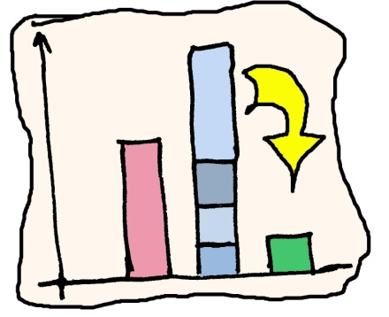
Bribery in Plurality
Setting
  We are given:
    An election E = (C,V)
    A preferred candidate p
    A budget k
  Question:
    Can we make p a winner by bribing voters of cost at most k?
Observation:
  It is sufficient to only look at each voter’s most preferred candidate
 | unpriced | priced
unweighted
weighted

Slide 79
Bribery in Plurality
Example:
  What is the cheapest way to make Alice a winner?
Setting
  We are given:
    An election E = (C,V)
    A preferred candidate p
    A budget k
  Question:
    Can we make p a winner by bribing voters of cost at most k?

Slide 80
Bribery in Plurality
Example:
  What is the cheapest way to make Alice a winner?
Setting
  We are given:
    An election E = (C,V)
    A preferred candidate p
    A budget k
  Question:
    Can we make p a winner by bribing voters of cost at most k?

Slide 81
Bribery in Plurality
Example:
  What is the cheapest way to make Alice a winner?
Setting
  We are given:
    An election E = (C,V)
    A preferred candidate p
    A budget k
  Question:
    Can we make p a winner by bribing voters of cost at most k?

Slide 82
Bribery in Plurality
Example:
  What is the cheapest way to make Alice a winner?
Setting
  We are given:
    An election E = (C,V)
    A preferred candidate p
    A budget k
  Question:
    Can we make p a winner by bribing voters of cost at most k?

Slide 83

Bribery in Plurality
Setting
  We are given:
    An election E = (C,V)
    A preferred candidate p
    A budget k
  Question:
    Can we make p a winner by bribing voters of cost at most k?
 | unpriced | priced
unweighted
weighted

Slide 84
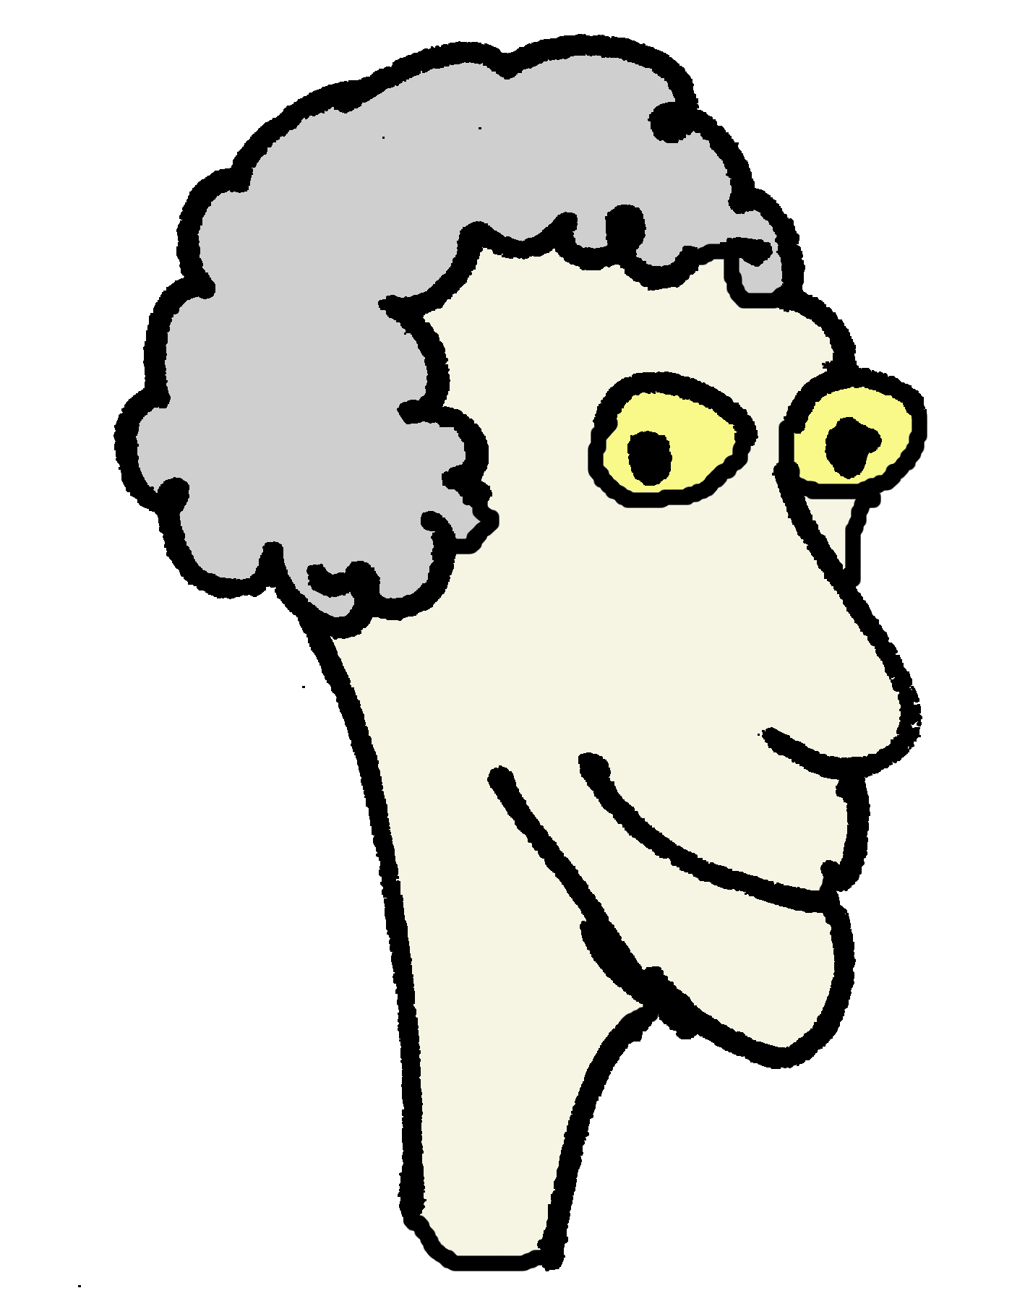

plurality-weighted-$bribery ∈ NP-com
Proof: Reduction from the subset-sum problem
Subset-Sum
plurality-weighted-$bribery
k = 17
Input: s₁, s₂, … , s_{n}
∑=34
12
1
5
10
12
6
10
6
Question: Is there a subsequence that sums up to exactly half.
5
1

Slide 85
plurality-weighted-$bribery ∈ NP-com
Proof: Reduction from the subset-sum problem
Subset-Sum
plurality-weighted-$bribery
k = 17
Input: s₁, s₂, … , s_{n}
∑=34
1
5
10
12
6
12
1
6
Question: Is there a subsequence that sums up to exactly half.
10
5

Slide 86
Bribery in Plurality
Setting
  We are given:
    An election E = (C,V)
    A preferred candidate p
    A budget k
  Question:
    Can we make p a winner by bribing voters of cost at most k?
 | unpriced | priced
unweighted
weighted

Slide 87
Weighted Bribery in Plurality
plurality-weighted-bribery
  Now voters have weights
What algorithms can we use?
  Heuristics:
    Heaviest voter first
    Winner’s heaviest voter first

Slide 88
Bribery in Plurality
Setting
  We are given:
    An election E = (C,V)
    A preferred candidate p
    A budget k
  Question:
    Can we make p a winner by bribing voters of cost at most k?
 | unpriced | priced
unweighted
weighted

Slide 89
Borda-$Bribery:
Para-NP-hardness!
Setting
Given: E = (C,V) – election,
p – preferred cand.
Question: Is it possible to ensure p’s victory by a given action, specified in the problem?
$Bribery
Action: Each voter has a price (possibly a unit) for changing his/her vote; we cannot exceed budget
N. Betzler, R. Niedermeier, G. Woeginger, Unweighted Coalitional Manipulation under the Borda Rule Is NP-Hard, IJCAI 2013
J. Davies, G. Katsirelos, N. Narodytska, T. Walsh, L. Xia, Complexity of and algorithms for the manipulation of Borda, Nanson's and Baldwin's voting rules, Artificial Intelligence 2014
M. Zuckerman, A. Procaccia, J. Rosenschein, Algorithms for the coalitional manipulation problem, Artificial Intelligence 2009
Manipulation
(strategic voting)
NP-hard for 2 manipulators and 3 nonmanipulators
Action: Fixed voters (the manipulators) can change their votes as they like

Slide 90
Borda-$Bribery:
Para-NP-hardness!
Setting
Given: E = (C,V) – election,
p – preferred cand.
Question: Is it possible to ensure p’s victory by a given action, specified in the problem?
$Bribery
Action: Each voter has a price (possibly a unit) for changing his/her vote; we cannot exceed budget
NP-hard for 5 voters and budget 2
Manipulation
(strategic voting)
NP-hard for 2 manipulators and 3 nonmanipulators
Action: Fixed voters (the manipulators) can change their votes as they like

Slide 91
Bribery and Friends
Setting
Given: E = (C,V) – election,
p – preferred cand.
Question: Is it possible to ensure p’s victory by a given action, specified in the problem?
($)Bribery
Action: Each voter has a price (possibly a unit) for changing his/her vote; we cannot exceed budget
Swap Bribery
Action: Each pair of candidates in each vote has a price for being swapped; we can swap cand’s when they are adjacent
Manipulation
(strategic voting)
E. Elkind, P. Faliszewski, A. Slinko, Swap Bribery, SAGT 2009.
B. Dorn, I. Schlotter, Multivariate Complexity Analysis of Swap Bribery, Algorithmica 2012
Action: Fixed voters (the manipulators) can change their votes as they like

Slide 92
Bribery and Friends
Setting
Given: E = (C,V) – election,
p – preferred cand.
Question: Is it possible to ensure p’s victory by a given action, specified in the problem?
($)Bribery
Action: Each voter has a price (possibly a unit) for changing his/her vote; we cannot exceed budget
Swap Bribery
Action: Each pair of candidates in each vote has a price for being swapped; we can swap cand’s when they are adjacent
Manipulation
(strategic voting)
Action: Fixed voters (the manipulators) can change their votes as they like

Slide 93
Bribery and Friends
Setting
Given: E = (C,V) – election,
p – preferred cand.
Question: Is it possible to ensure p’s victory by a given action, specified in the problem?
($)Bribery
Action: Each voter has a price (possibly a unit) for changing his/her vote; we cannot exceed budget
Swap Bribery
Action: Each pair of candidates in each vote has a price for being swapped; we can swap cand’s when they are adjacent
Manipulation
(strategic voting)
Action: Fixed voters (the manipulators) can change their votes as they like

Slide 94
Bribery and Friends
Setting
Given: E = (C,V) – election,
p – preferred cand.
Question: Is it possible to ensure p’s victory by a given action, specified in the problem?
E. Elkind, P. Faliszewski, A. Slinko, Swap Bribery, SAGT 2009.
E. Elkind, P. Faliszewski, Approximation Algorithms for Campaign Management, WINE 2010
R. Bredereck, J. Chen, P. Faliszewski, A. Nichterlein, R. Niedermeier, Prices Matter for the Parametrized Complexity of Shift Bribery, Information and Computation 2016
R. Bredereck, P. Faliszewski, R. Niedermeier, N. Talmon, Complexity of Shift Bribery in Committee Elections, AAAI 2016
($)Bribery
Action: Each voter has a price (possibly a unit) for changing his/her vote; we cannot exceed budget
Swap Bribery
Action: Each pair of candidates in each vote has a price for being swapped; we can swap cand’s when they are adjacent
Manipulation
(strategic voting)
Action: Fixed voters (the manipulators) can change their votes as they like
Shift Bribery
Action: We can shift p forward in each vote, for a given price

Slide 95




Shift-Bribery Problem
3 2 1 0
Scores
v₁: > > >
→ 7
v₂: > > >
→ 3
v₃: > > >
→ 8
v₄: > > >
→ 6

Slide 96
Shift-Bribery Problem
3 2 1 0
Scores
v₁: > > >
→ 7
v₂: > > >
→ 3
2
v₃: > > >
→ 8
→ 7
→ 6
v₄: > > >
→ 8
Shifting our candidate by k position in the i’th vote costs π_{i}(k)

Slide 97
The Complexity of Shift-Bribery
Voting rule Worst-Case Approx.ratio
Plurality P ―
Veto P ―
k-approval P ―
Borda NP-com 2
Maximin NP-com O(logm)
Copeland NP-com O(m)
Intuitively… the nature of shift-bribery price functions matters. For example, the 2-approximation algorithm is much faster for unit prices, and NP-hardness proofs use all-or-nothing price functions

Slide 98







The Algorithm
Why 2-approximation?
>
>
>
α_{i+1}
α_{i}
gains α_{i+1} – α_{i} points
loses α_{i+1} – α_{i} points
Getting 2x the points for than the best bribery gives is sufficient to win

Slide 99
The Algorithm
Why 2-approximation?
Operation of the algorithm
Guess a cost k
Get most points for at cost k
Guess a cost k’ <= k
Get most points for at cost k’
>
>
>
α_{i+1}
α_{i}
gains α_{i+1} – α_{i} points
loses α_{i+1} – α_{i} points
This is a 2-approximation… but works in polynomial time only if prices are encoded in unary
Getting 2x the points for than the best bribery gives is sufficient to win

Slide 100
Why Does the Algorithm Work?
How much does optimal solution shift candidate p in each vote?
v₁
v₂
v₃
v₄
v₅
O – the optimal solution → gives p some T points
Operation of the algorithm
Guess a cost k
Get most points for p at cost k
Guess a cost k’ <= k
Get most points for p at cost k’

Slide 101
Why Does the Algorithm Work?
How much does optimal solution shift candidate p in each vote?
v₁
v₂
v₃
v₄
v₅
O – the optimal solution → gives p some T points

Slide 102
Why Does the Algorithm Work?
How much does optimal solution shift candidate p in each vote?
v₁
v₂
v₃
v₄
v₅
O – the optimal solution → gives p some T points
S – solution that gives most points at cost k

Slide 103
Why Does the Algorithm Work?
How much does optimal solution shift candidate p in each vote?
v₁
v₂
v₃
v₄
v₅
O – the optimal solution → gives p some T points
S – solution that gives most points at cost k
min(O,S) – min shift of the two in each vote
gives some D points to p
Now it is possible to complete min(O,S) in two independent ways:
By continuing as S does (getting at least T-D points extra)
By continuing as O does (getting T-D points extra)

Slide 104
Why Does the Algorithm Work?
How much does optimal solution shift candidate p in each vote?
v₁
v₂
v₃
v₄
v₅
Now it is possible to complete min(O,S) in two independent ways:
By continuing as S does (getting at least T-D points extra)
By continuing as O does (getting T-D points extra)
After we perform shifts from min(O,S), there is a way to make p win by shifts that give him T-D points
Thus, any shift that gives him 2(T-D) points, makes him a winner.
It is easy to find these 2(T-D) points. We’re done!

Slide 105
The Algorithm (General Case)
2-approximation algorithm for unary prices
Scaling argument + twists
2+ε-approximation scheme for any prices
Bootstrapping-flavored argument
2-approximation algorithm for any prices

Slide 106
The Algorithm
Why 2-approximation?
Operation of the algorithm
Guess a cost k
Get most points for at cost k
Guess a cost k’ <= k
Get most points for at cost k’
>
>
>
α_{i+1}
α_{i}
gains α_{i+1} – α_{i} points
loses α_{i+1} – α_{i} points
Is this algorithm still a
2-approximation?

Slide 107
The Complexity of Shift-Bribery… Now!
Voting rule Worst-Case Approx.ratio
Plurality P ―
Veto P ―
k-approval P ―
Borda NP-com 2
Maximin NP-com O(logm)
Copeland NP-com O(m)

Slide 108
The Complexity of Shift-Bribery… Now!
Voting rule Worst-Case Approx.ratio
Plurality P ―
Veto P ―
k-approval P ―
Borda NP-com PTAS ← best possible!
Maximin NP-com O(logm)
Copeland NP-com O(m) ← best possible!
Theorem: There is a PTAS for Shift-Bribery for all positional scoring rules

Slide 109


Sneak Preview: PTAS for Borda with Unit Prices
Original scores
s’s gain from shifts
Overflow points
Borda score
c₁
c₂
c₃
c₄
p
c₅
Candidates (sorted by score)

Slide 110
Sneak Preview: PTAS for Borda with Unit Prices
Original scores
s’s gain from shifts
Overflow points
Borda score
Lemma: In a successful shift bribery it must hold that:
≥
c₁
c₂
c₃
c₄
p
c₅
Algorithm: Guess a number k of shifts of that satifsy the lemma.
Let C_{bad} be the candidates with overflow points, assuming we make (1+ε)k shifts. Find optimal cost of beating them (DP)
Make additional shifts, to ensure (1+ε)k shifts.
Candidates (sorted by score)
Trick: The DP is exponential, but due to the lamma |C_{bad}| ≤ 1/ε , so we manage ☺

Slide 111
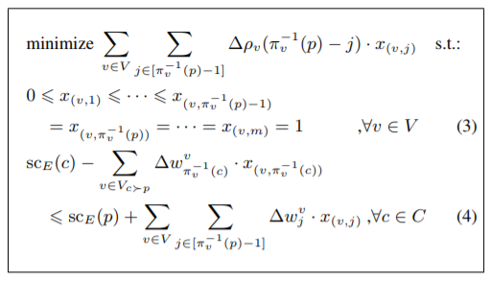
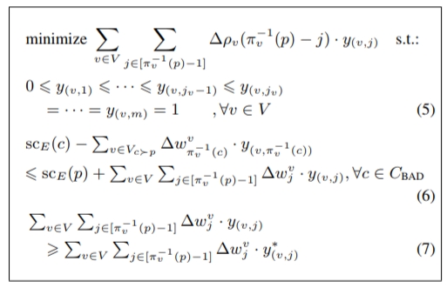
PTAS for Positional Scoring Rules
Algorithm: Solve first LP to get rough idea of a solution
Complications: Things get harder.
Different shift make different point contributions
Getting one more point can be much more expensive
Solve second LP (formed based on the rough solution) and get the final solution by rounding
Very roughly speaking: Idea similar to the previous one, but much more involved technically

Slide 112
winner determination
possible and necessary winners
winner prediction
margin of victory
problem families
campaign management
bribery
control
changing
the result
strategic voting (manipulation)
Computational Social Choice
(voting)
Plurality
Borda
t-Approval
scoring rules
Bucklin
other ideas
(iterative etc.)
election formalism
(single winner)
STV
ordinal
Copeland
approval-based
Maximin
Condorcet rules
(graphs!)
Dodgson

Slide 113
Constructive Control by Adding Candidates
Plurality-CCAC
Given:
E = (C, V) – an election
A – additional candidates
p in C – preferred candidate
k – budget
Question:
Is it possible to ensure p’s victory by
adding at most k candidates

Slide 114





Constructive Control by Adding Candidates
Plurality-CCAC
Given:
E = (C, V) – an election
A – additional candidates
p in C – preferred candidate
k – budget
Question:
Is it possible to ensure p’s victory by
adding at most k candidates
> > > >
> > > >
> > > >
> > > >
> > > >
p =
k = 2

Slide 115






Control by Adding Candidates ∈ NP-com
Proof: Reduction from the X3C problem
Exact Cover by 3-Sets
Control by Adding Candidates
Input: B = {b₁, b₂, b₃, … , b_{3k}}
S = {S₁, …, S_{n}}
B = { }
S₁={ }
S₂={ }
S₃={ }
S₄={ }
S₅={ }
s(p) = T+1
s( ) = s( )= s( ) = T+1
s( ) = s( )= s( ) = T+1
S₁: > > …
> > …
> > …
S₃: > > …
> > …
> > …
S₅: > >
> >
> >
S₂: > > …
> > …
> > …
S₄: > > …
> > …
> > …
Question: Is it possible to pick k
sets and cover all elements from B?

Slide 116
Control by Adding Candidates ∈ NP-com
Proof: Reduction from the X3C problem
Exact Cover by 3-Sets
Control by Adding Candidates
Input: B = {b₁, b₂, b₃, … , b_{3k}}
S = {S₁, …, S_{n}}
B = { }
S₁={ }
S₂={ }
S₃={ }
S₄={ }
S₅={ }
s(p) = T+1
s( ) = s( )= s( ) = T+1
s( ) = s( )= s( ) = T+1
S₁: > > …
> > …
> > …
S₃: > > …
> > …
> > …
S₅: > >
> >
> >
S₂: > > …
> > …
> > …
S₄: > > …
> > …
> > …
Question: Is it possible to pick k
sets and cover all elements from B?

Slide 117
winner determination
possible and necessary winners
winner prediction
margin of victory
problem families
campaign management
bribery
control
changing
the result
strategic voting (manipulation)
Computational Social Choice
(voting)
Plurality
Borda
t-Approval
scoring rules
Bucklin
other ideas
(iterative etc.)
election formalism
(single winner)
STV
ordinal
Copeland
approval-based
Maximin
Condorcet rules
(graphs!)
Dodgson

Slide 118
winner determination
possible and necessary winners
winner prediction
margin of victory
problem families
campaign management
Approximation!
bribery
control
changing
the result
strategic voting (manipulation)
Computational Social Choice
(voting)
Plurality
Borda
t-Approval
scoring rules
Bucklin
other ideas
(iterative etc.)
election formalism
(single winner)
STV
ordinal
Copeland
approval-based
Maximin
Condorcet rules
(graphs!)
Dodgson

Slide 119
winner determination
possible and necessary winners
winner prediction
margin of victory
problem families
campaign management
bribery
parameters
control
changing
the result
strategic voting (manipulation)
Computational Social Choice
(voting)
Plurality
Borda
t-Approval
scoring rules
Bucklin
other ideas
(iterative etc.)
election formalism
(single winner)
STV
ordinal
Copeland
approval-based
Maximin
Condorcet rules
(graphs!)
Dodgson

Slide 120
Fixed-Parameter Tractable Algorithms (FPT)

Slide 121
Exponential running time
f(n) = O(2^{n}poly(n)) = O*(2^{n})
What can we do if the problem has exponential running time?

Slide 122
Fixed-Parameter Tractability
f(n,k) = O(h(k)poly(n)) = O*(h(k))
Part of the data is a parameter (e.g., #voters or #candidates)
NP-hard
h(k)
FPT
versus

Slide 123
W-hierarchy
XP
…
W[2]
W[1]
FPT
XP – problems solvable in polynomial time, assuming the parameter is constant

Slide 124
FPT vs XP
f(n,k) = O(2^{k}n)
f(n,k) = O(n^{k})
FPT
XP
FPT – exponential part of the running time depends on the parameter only
XP – problems solvable in polynomial time, assuming the parameter is constant

Slide 125
winner determination
possible and necessary winners
#voters
election size
winner prediction
#candidates
margin of victory
budget / cost
problem families
campaign management
special features
bribery
parameters
control
changing
the result
strategic voting (manipulation)
Computational Social Choice
(voting)
Plurality
Borda
t-Approval
scoring rules
Bucklin
other ideas
(iterative etc.)
election formalism
(single winner)
STV
ordinal
Copeland
approval-based
Maximin
Condorcet rules
(graphs!)
Dodgson

Slide 126
Dodgson Score: FPT(m)
V₁:
Dodgson Score of candidate c: Smallest numer of swaps of adjacent candidates that ensures that cancidate c is a Condorcet winner
V₂:
V₃:
V₄:
Parameter : Number of Candidates (m)
Answer : ILP
V₅:
V₆:

Slide 127
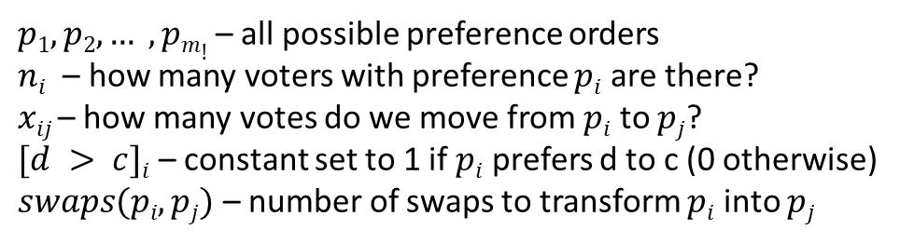
Dodgson Score: FPT(m)
V₁:
Dodgson Score of candidate c: Smallest numer of swaps of adjacent candidates that ensures that cancidate c is a Condorcet winner
V₂:
V₃:
V₄:
Parameter : Number of Candidates (m)
Answer : ILP
V₅:
$p1, p2, … , pm!$– all possible preference orders
$ni$ – how many voters with preference $pi$ are there?
$xij$– how many votes do we move from $pi$ to $pj$?
$[d > c]i$ – constant set to 1 if $pi$ prefers d to c (0 otherwise)
$swaps(pi,pj)$ – number of swaps to transform $pi$ into $pj$
V₆:

Slide 128
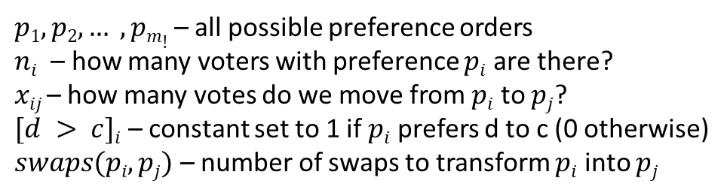
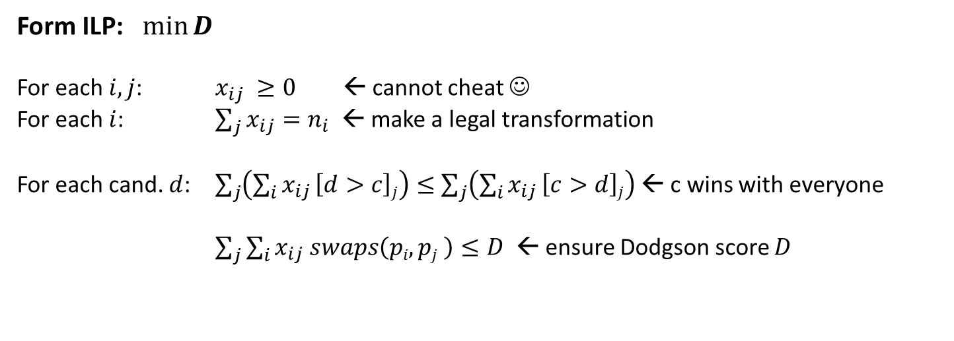
Dodgson Score:FPT(m)
V₁:
Dodgson Score of candidate c: Smallest numer of swaps of adjacent candidates that ensures that cancidate c is a Condorcet winner
V₂:
Parameter : Number of Candidates (m)
Answer : ILP
V₃:
V₄:
$p1, p2, … , pm!$– all possible preference orders
$ni$ – how many voters with preference $pi$ are there?
$xij$– how many votes do we move from $pi$ to $pj$?
$[d > c]i$ – constant set to 1 if $pi$ prefers d to c (0 otherwise)
$swaps(pi,pj)$ – number of swaps to transform $pi$ into $pj$
V₅:
V₆:
Form ILP: $min⁡D$
For each $i,j$: $x_{ij} ≥0$ ← cannot cheat ☺
For each $i$: $\sum_{j}{x_{ij}=n_{i}}$ ← make a legal transformation
For each cand. $d$: $\sum_{j}{\left(\sum_{i}{x_{ij}}\left[d>c\right]j\right)≤}$ $\sum_{j}{\left(\sum_{i}{x_{ij}}\left[c>d\right]j\right)}$ ← c wins with everyone
$\sum_{j}{\sum_{i}{x_{ij} swaps\left(pi,pj \right)≤D}}$ ← ensure Dodgson score $D$
Solve the ILP in FPT time using Lenstra!

Slide 129
winner determination
possible and necessary winners
#voters
election size
winner prediction
#candidates
margin of victory
budget / cost
problem families
campaign management
special features
bribery
parameters
control
changing
the result
strategic voting (manipulation)
Computational Social Choice
(voting)
Plurality
Borda
t-Approval
scoring rules
Bucklin
other ideas
(iterative etc.)
election formalism
(single winner)
STV
ordinal
Copeland
approval-based
Maximin
Condorcet rules
(graphs!)
Dodgson

Slide 130
Borda-$Bribery:
Para-NP-hardness!
Setting
Given: E = (C,V) – election,
p – preferred cand.
Question: Is it possible to ensure p’s victory by a given action, specified in the problem?
$Bribery
Action: Each voter has a price (possibly a unit) for changing his/her vote; we cannot exceed budget
NP-hard for 5 voters and budget 2
Manipulation
(strategic voting)
NP-hard for 2 manipulators and 3 nonmanipulators
Action: Fixed voters (the manipulators) can change their votes as they like

Slide 131
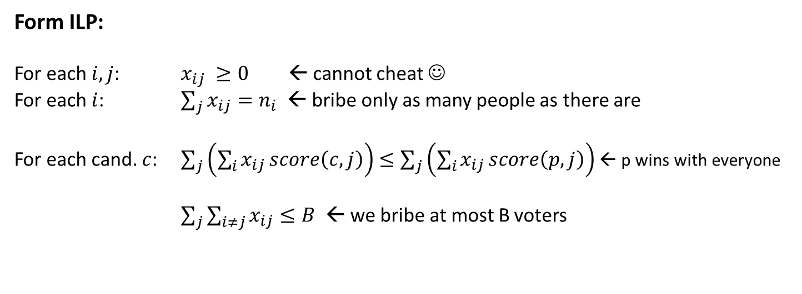
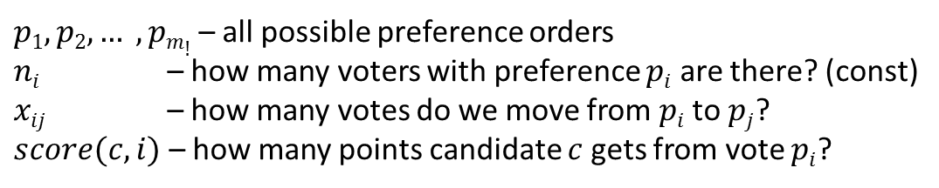
Borda-Bribery:
FPT for #candidates
Setting
Given: E = (C,V) – election (voters have prices)
p – preferred cand.
B – budget
Question: Is it possible to ensure p’s victory by bribing voters of total cost at most B?
$p1, p2, … , pm!$– all possible preference orders
$ni$ – how many voters with preference $pi$ are there? (const)
$xij$ – how many votes do we move from $pi$ to $pj$?
$score(c,i)$ – how many points candidate $c$ gets from vote $pi$?
Solve the ILP in FPT time using Lenstra!
Form ILP:
For each $i,j$: $x_{ij} ≥0$ ← cannot cheat ☺
For each $i$: $\sum_{j}{x_{ij}=n_{i}}$ ← bribe only as many people as there are
For each cand. $c$: $\sum_{j}{\left(\sum_{i}{x_{ij}}score\left(c,j\right)\right)≤}$ $\sum_{j}{\left(\sum_{i}{x_{ij}}score\left(p,j\right)\right)}$ ← p wins with everyone
$\sum_{j}{\sum_{i≠j}{x_{ij}≤B}}$ ← we bribe at most B voters

Slide 132
Borda-$Bribery:
FPT for #candidates
Setting
Given: E = (C,V) – election (voters have prices)
p – preferred cand.
B – budget
Question: Is it possible to ensure p’s victory by bribing voters of total cost at most B?
What if voters have prices?
$p1, p2, … , pm!$– all possible preference orders
$ni$ – how many voters with preference $pi$ are there? (const)
$xij$ – how many votes do we move from $pi$ to $pj$?
$score(c,i)$ – how many points candidate $c$ gets from vote $pi$?
Form ILP:
For each $i,j$: $x_{ij} ≥0$ ← cannot cheat ☺
For each $i$: $\sum_{j}{x_{ij}=n_{i}}$ ← bribe only as many people as there are
For each cand. $c$: $\sum_{j}{\left(\sum_{i}{x_{ij}}score\left(c,j\right)\right)≤}$ $\sum_{j}{\left(\sum_{i}{x_{ij}}score\left(p,j\right)\right)}$ ← p wins with everyone
$\sum_{j}{\sum_{i≠j}{x_{ij}≤B}}$ ← we bribe at most B voters

Slide 133
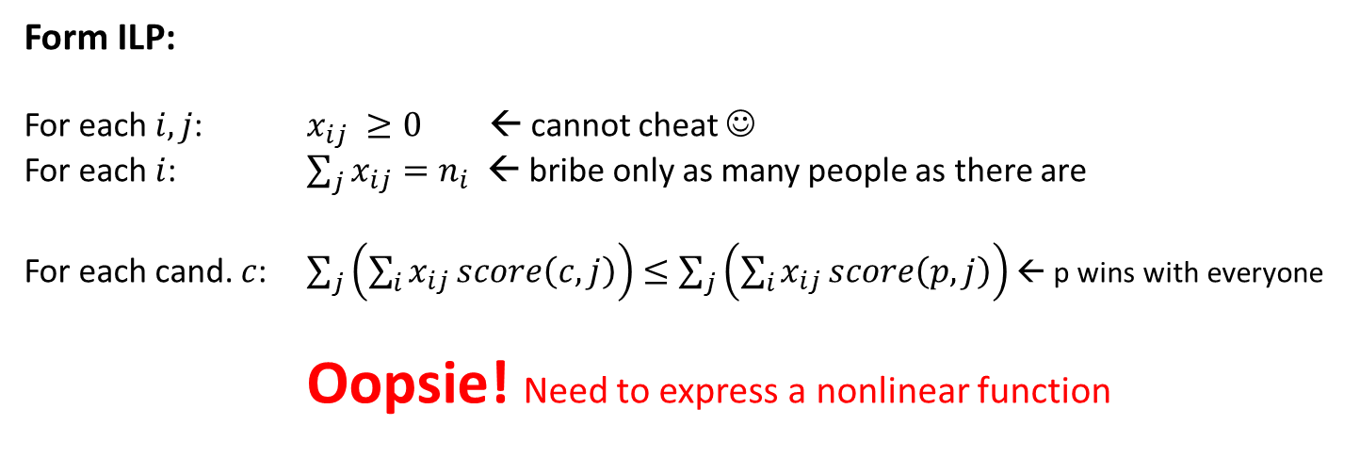
Borda-$Bribery:
FPT for #candidates
Setting
Given: E = (C,V) – election (voters have prices)
p – preferred cand.
B – budget
Question: Is it possible to ensure p’s victory by bribing voters of total cost at most B?
What if voters have prices?
$p1, p2, … , pm!$– all possible preference orders
$ni$ – how many voters with preference $pi$ are there? (const)
$xij$ – how many votes do we move from $pi$ to $pj$?
$score(c,i)$ – how many points candidate $c$ gets from vote $pi$?
Form ILP:
For each $i,j$: $x_{ij} ≥0$ ← cannot cheat ☺
For each $i$: $\sum_{j}{x_{ij}=n_{i}}$ ← bribe only as many people as there are
For each cand. $c$: $\sum_{j}{\left(\sum_{i}{x_{ij}}score\left(c,j\right)\right)≤}$ $\sum_{j}{\left(\sum_{i}{x_{ij}}score\left(p,j\right)\right)}$ ← p wins with everyone
Oopsie! Need to express a nonlinear function

Slide 134




Encoding Cost of $Bribing x_{ij} Voters p_{i} to p_{j}
$Bij$– cost of bribing $pi$ to $pj$
$$Bij≥a_{1}x_{ij}$$
$$Bij$$
Cost
$$y = a1x$$
1 2 3 4 5
Number of voters bribed
(bribe cheapest first)

Slide 135


Encoding Cost of $Bribing x_{ij} Voters p_{i} to p_{j}
$Bij$– cost of bribing $pi$ to $pj$
$$Bij≥a_{1}x_{ij}$$
$$Bij$$
$$Bij≥a_{2}x_{ij}$$
Cost
$$y = a2x$$
$$y = a1x$$
1 2 3 4 5
Number of voters bribed
(bribe cheapest first)

Slide 136


Encoding Cost of $Bribing x_{ij} Voters p_{i} to p_{j}
$Bij$– cost of bribing $pi$ to $pj$
$$Bij≥a_{1}x_{ij}$$
$$Bij$$
$$Bij≥a_{2}x_{ij}$$
$$y = a3x$$
$$Bij≥a_{3}x_{ij}$$
Cost
$$y = a2x$$
$$y = a1x$$
1 2 3 4 5
Number of voters bribed
(bribe cheapest first)

Slide 137


Encoding Cost of $Bribing x_{ij} Voters p_{i} to p_{j}
$Bij$– cost of bribing $pi$ to $pj$
$$y = a4x$$
$$Bij≥a_{1}x_{ij}$$
$$Bij$$
$$Bij≥a_{2}x_{ij}$$
$$y = a3x$$
$$Bij≥a_{3}x_{ij}$$
Cost
$$y = a2x$$
$$Bij≥a_{4}x_{ij}$$
$$y = a1x$$
1 2 3 4 5
Number of voters bribed
(bribe cheapest first)

Slide 138


Encoding Cost of $Bribing x_{ij} Voters p_{i} to p_{j}
$$y = a5x$$
$Bij$– cost of bribing $pi$ to $pj$
$$y = a4x$$
$$Bij≥a_{1}x_{ij}$$
$$Bij$$
$$Bij≥a_{2}x_{ij}$$
$$y = a3x$$
$$Bij≥a_{3}x_{ij}$$
Cost
$$y = a2x$$
$$Bij≥a_{4}x_{ij}$$
$$y = a1x$$
$$Bij≥a_{5}x_{ij}$$
1 2 3 4 5
Number of voters bribed
(bribe cheapest first)

Slide 139
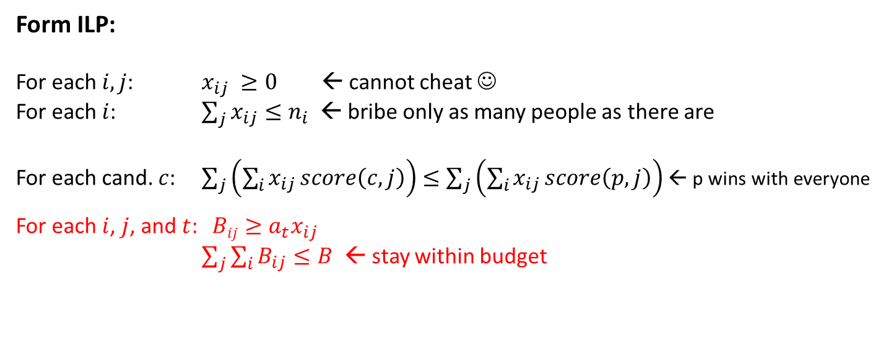
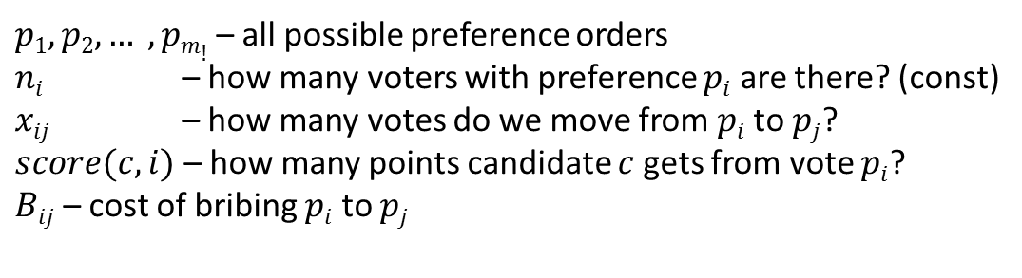
Borda-$Bribery:
FPT for #candidates
Setting
Given: E = (C,V) – election (voters have prices)
p – preferred cand.
B – budget
Question: Is it possible to ensure p’s victory by bribing voters of total cost at most B?
$p1, p2, … , pm!$– all possible preference orders
$ni$ – how many voters with preference $pi$ are there? (const)
$xij$ – how many votes do we move from $pi$ to $pj$?
$score(c,i)$ – how many points candidate $c$ gets from vote $pi$?
$Bij$– cost of bribing $pi$ to $pj$
Solve the MILP in FPT time using Lenstra!
Form ILP:
For each $i,j$: $x_{ij} ≥0$ ← cannot cheat ☺
For each $i$: $\sum_{j}{x_{ij}≤n_{i}}$ ← bribe only as many people as there are
For each cand. $c$: $\sum_{j}{\left(\sum_{i}{x_{ij}}score\left(c,j\right)\right)≤}$ $\sum_{j}{\left(\sum_{i}{x_{ij}}score\left(p,j\right)\right)}$ ← p wins with everyone
For each $i$, $j$, and $t$: $Bij≥a_{t}x_{ij}$
$\sum_{j}{\sum_{i}{B_{ij}≤B}}$ ← stay within budget

Slide 140
winner determination
possible and necessary winners
#voters
election size
winner prediction
#candidates
margin of victory
budget / cost
problem families
campaign management
special features
bribery
parameters
control
changing
the result
strategic voting (manipulation)
Computational Social Choice
(voting)
Plurality
Borda
t-Approval
scoring rules
Bucklin
other ideas
(iterative etc.)
election formalism
(single winner)
STV
ordinal
Copeland
approval-based
Maximin
Condorcet rules
(graphs!)
Dodgson

Slide 141
Plurality-CCAC: W[1]-hard for #voters
Plurality-CCAC
Given:
E = (C, V) – an election
A – additional candidates
p in C – preferred candidate
k – budget
Question:
Is it possible to ensure p’s victory by
adding at most k candidates
> > > >
> > > >
> > > >
> > > >
> > > >
W[1]-hardness via a somewhat tricky reduction from the Clique problem
J. Chen, P. Faliszewski, R. Niedermeier, N. Talmon , Elections with Few Voters: Candidate Control Can Be Easy, Journal of Artificial Intelligence Research, 2017 (AAAI-2015)
C. Maushagen, J. Rothe, Complexity of Control by Partitioning Veto and Maximin Elections and of Control by Adding Candidates to Plurality Elections, ECAI 2016

Slide 142
Plurality-DCAC: FPT for #voters
Plurality-DCAC
Given:
E = (C, V) – an election
A – additional candidates
d in C – despised candidate
k – budget
Question:
Is it possible to ensure d’s defeat by
adding at most k candidates
> > > >
> > > >
> > > >
> > > >
> > > >

Slide 143




Plurality-DCAC: FPT for #voters
Algorithm
Example
Despised :
Guess a defeator:
(add if needed)
> > > >
> > > >
> > > >
> > > >

Slide 144


Plurality-DCAC: FPT for #voters
Algorithm
Example
Despised :
Guess a defeator:
(add if needed)
Voters where either or is first
(or some other registered candidate is ahead)
(cannot do much about them)
Ensure that the defeator has more points than despised
Voters to focus on:
n voters → each candidate has one of 4^{n} signatures
> > > >
> > > >
> > > >
> > > >

Slide 145
Plurality-DCAC: FPT for #voters
Algorithm
Example
Despised :
Guess a defeator:
(add if needed)
Voters where either or is first
(or some other registered candidate is first)
(cannot do anything about them)
Ensure that the defeator has more points than despised
Voters to focus on:
> > > >
> > > >
> > > >
> > > >
n voters → each candidate has one of 4^{n} signatures
A
B
suffices to keep one candidate for each signature
C
D

Slide 146
Plurality-DCAC: FPT for #voters
Algorithm
Example
Despised :
Guess a defeator:
(add if needed)
Voters where either or is first
(or some other registered candidate is first)
(cannot do anything about them)
Ensure that the defeator has more points than despised
Voters to focus on:
> > > >
> > > >
> > > >
> > > >
n voters → each candidate has one of 2^{n} signatures
A
B
suffices to keep one candidate for each signature
Kernel!
B
suffices to keep at most n registered candidates
(the top-ranked registered candidate for each vote)
B

Slide 147
winner determination
possible and necessary winners
#voters
election size
winner prediction
#candidates
margin of victory
budget / cost
problem families
campaign management
special features
bribery
parameters
control
Restricted domains
changing
the result
strategic voting (manipulation)
Computational Social Choice
(voting)
Plurality
Borda
t-Approval
scoring rules
Bucklin
other ideas
(iterative etc.)
election formalism
(single winner)
STV
ordinal
Copeland
approval-based
Maximin
Condorcet rules
(graphs!)
Dodgson

Slide 148







Dodgson in Single-Peaked Elections
> > > >
> > > >
> > > >
> > > >
> > > >
> > > >
> > > >
left
right
Theorem
If election E = (C,V) is single-peaked and the numer of voters is odd, then the top-ranked candidate of the median voter is a Condorcet winner
median voter
Theorem
Computing Dodgson winners under single-peaked elections is in P

Slide 149
Dodgson in Single-Peaked Elections
> > > >
> > > >
> > > >
> > > >
> > > >
> > > >
> > > >
left
right
Idea: Parameterize by distance from being single-peaked?
D. Cornaz, L. Galand, O. Spanjaard, Kemeny Elections with Bounded Single-Peaked or Single-Crossing Width, IJCAI-2013
D. Cornaz, L. Galand, O. Spanjaard, Bounded Single-Peaked Width and Proportional Representation, ECAI-2012
P. Faliszewski, E. Hemaspaandra, L. Hemaspaandra, The complexity of manipulative attacks in nearly single-peaked electorates. Artificial Intelligence, 2014
G. Erdélyi, M. Lackner, A. Pfandler: Computational Aspects of Nearly Single-Peaked Electorates, JAIR 2017

Slide 150








Single-Peaked Width
> > > > > > > >…
> > > > > > > >…
> > > > > > > >…
> > > > > > > >…
> > > > > > > >…
> > > > > > > >…
> > > > > > > >…
left
right

Slide 151
Single-Peaked Width
> > > > > > > >…
> > > > > > > >…
> > > > > > > >…
> > > > > > > >…
> > > > > > > >…
> > > > > > > >…
> > > > > > > >…
left
right
Problem!
Very fragile to perturbations in single votes. Still – an attempt at treewidth-like notion.

Slide 152
Summary: Computational Social Choice
  Mix of computer science and economics
    Approximation for COMSOC is nice, but does not solve all the problems
    Sometimes FPT algorithms are the only way
  Becomes more and more realistis
    Winner determination
    Margin of victory
    Bribery as a measure of success
    … lots of others
  Motivation matters
    It’s not enough to get a nice algorithm …
    … it has to address some real issue

Slide 153

Thank you!

