Slide 1
Introduction to crowdsourcing…
Ben Livshits
Microsoft Research

Slide 2
Introduction to Crowdsourcing
CrowdBoost:
Applications of the ideas of crowdsourcing to creating programs automatically

Slide 3
Most Popular Crowdsourcing Site
Amazon Mechanical Turk is a crowdsourcing Internet marketplace that enables computer programmers (Requesters) to coordinate the use of human intelligence (of workers) to perform tasks which computers are unable to do.

Slide 4
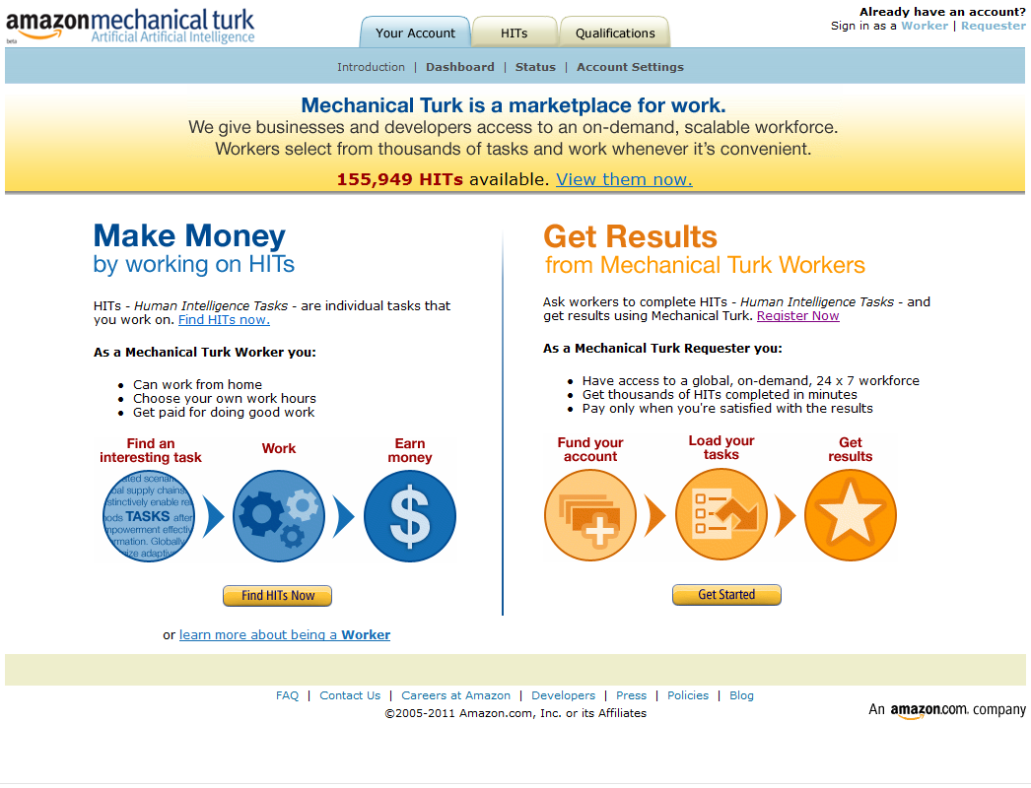
https://www.mturk.com/

Slide 5
Workers get paid to answer stuff.

Slide 6
Requesters pay to ask stuff.

Slide 7
HITs (Human Intelligence Tasks)
Requesters can specify:
  task
  keywords
  expiration date
  reward
  time allotted
  worker qualifications
    location
    approval rating
“Identify forward-facing pictures of dogs”
“Find and enter a business address”
“How attractive are these items?”
“Choose the best category for this product”
“Read a set of Tweets and decide if they describe an event”

Slide 8
Why Use Crowdsourcing?
Advantages of Mechanical Turk*:
  low cost ($0.10 per 60-second task)
  subject pool size
  subject pool diversity
  faster theory/experiment cycle

Slide 9
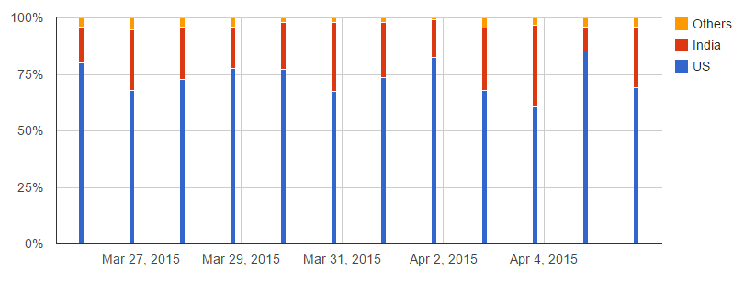
Countries

Slide 10
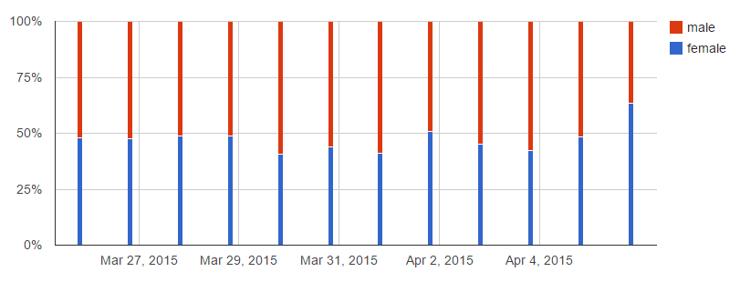
Gender

Slide 11
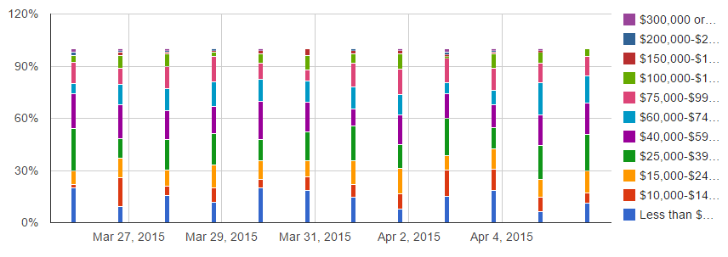
Income Level

Slide 12
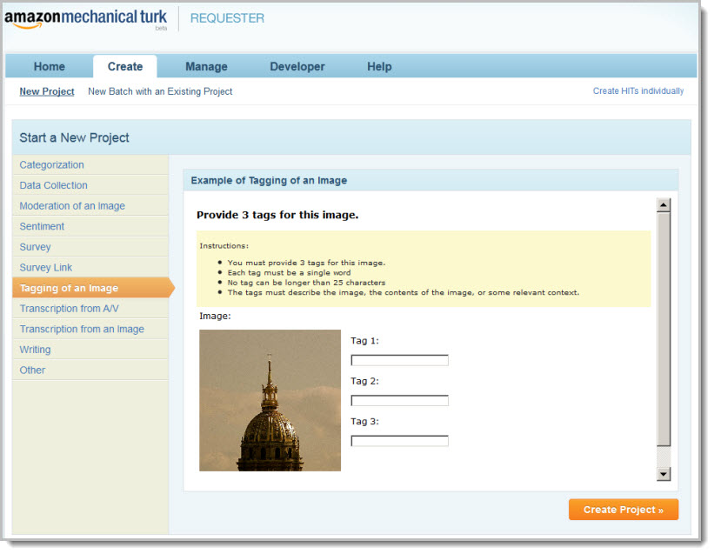
Template for Image Tagging

Slide 13
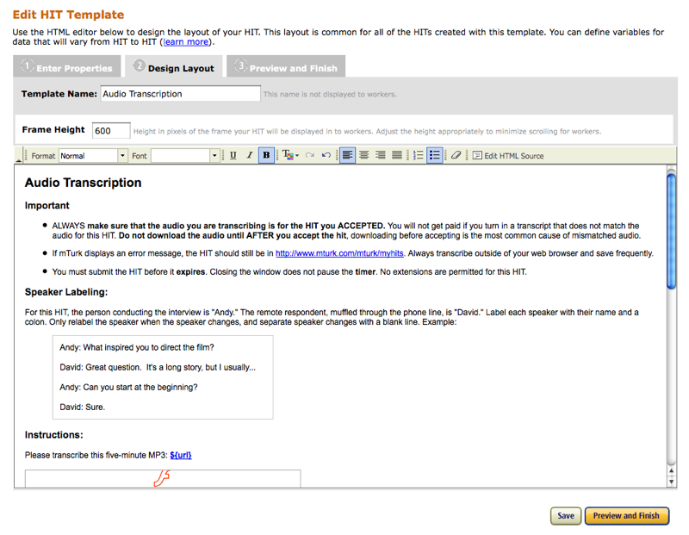
Template for Audio Transcription

Slide 14
Terminology
Requester
Worker
HIT (human interest task)
Issues:
  Quality of responses
  Attracting workers to your HIT
  Figuring out how much to pay workers
  Intellectual property leakage
  No time constraint
  Not much control over development or ultimate product
  Ill-will with own employees
  Choosing what to crowdsource & what to keep in-house

Slide 15
Mechanical Turk Payments
HITs must be prepaid to a Mechanical Turk account
  Amazon collects 10% on top of what you pay to Workers
  Amazon collects 10% of any bonuses you grant
  Payment to Workers can be in money or Amazon credit
You’re ultimately only charged for approved HITs, but you’re liable for the amount equal to whatever 100% approved HITs would cost.
You’ll have to deal with tax stuff if Workers do enough work for you to meet the IRS threshold for taxable income.
Click for prepaid terms and tax information.

Slide 16
How Much Does a Worker Make
Anecdotally:
My Personal MTurk Earnings Ledger – How I earned $26.80 in 2 hours:
HIT: Write 250 word article reviewing outdoor wedding venue (9 minutes, $2.50)
HIT: Write 250 word article reviewing wedding venue in Atlanta, GA (9 minutes, $2.55)
HIT: Survey on my consumer electronics buying habits (15 minutes, $2.00)
HIT: Write 250 word article reviewing rented meeting space in Manhattan (8 minutes, $2.55)
HIT: Write 250 word article reviewing conference center in Los Angeles, CA (8 minutes, $2.55)
HIT: Survey for people who have been employed as paralegals (12 minutes, $1.50)
HIT: Survey for people who have been employed as attorneys (10 minutes, $1.50)
HIT: Survey about education history for lawyers (12 minutes, $1.00)
HIT: Write a 300 word article on grandfather clocks (16 minutes, $2.90 + $1.75 bonus)
HIT: Write an 80 word unique product description (11 minutes, $3.00 + $2.00 bonus)
HIT: Survey about personal political opinions (7 minutes, $1.00)
TOTAL EARNINGS: $26.80 (including bonuses)/2 hours
DERIVATIVE HOURLY RATE: $13.40/hour

Slide 17
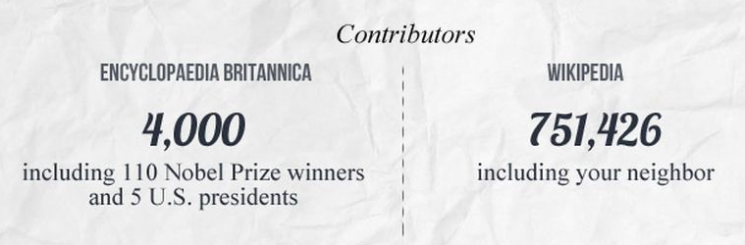
Wikipedia

Slide 18
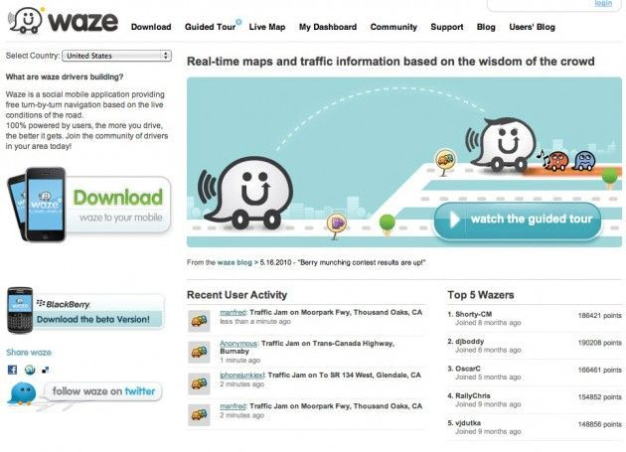
Maps and Traffic Information

Slide 19
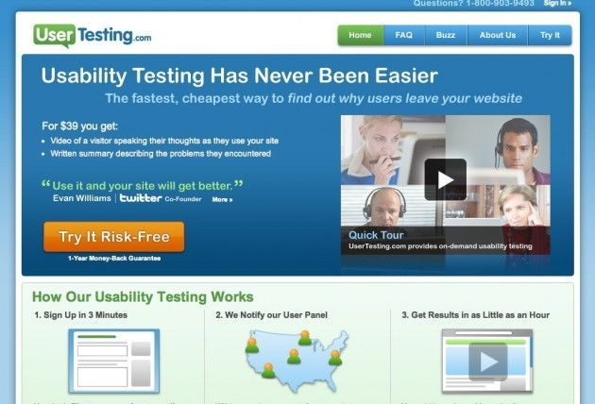
Web Usability Testing:
UserTesting.com & Feedback Army

Slide 20
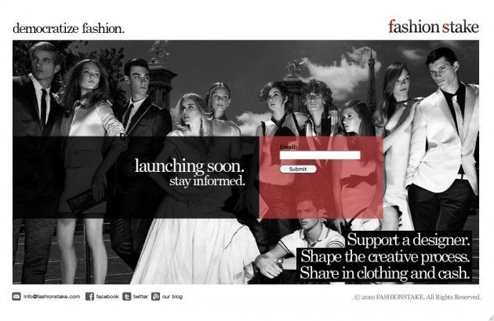
Fashion Design - Fashion Stake

Slide 21
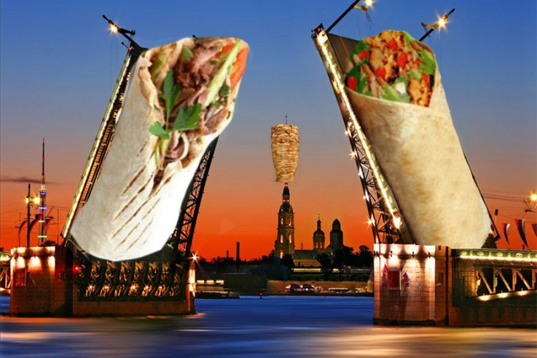
В Санкт-Петербурге организовали краудсорсинг-проект по поиску лучшей шавермы
ОБЩЕСТВО 6 июня 2015, 02:01.
В середине мая в социальной сети «В Контакте» появился интересный проект — группа «Обзоры шавермы в Питере и области». Шавермой в северной столице принято называть то, что в остальных городах и весях нашей необъятной родины зовут шаурмой.
Пользователи сообщества активно делятся информацией о популярном фастфуде. А другой питерский проект «Бумага» создал на основе этих отзывов интерактивную карту Петербурга, с помощью которой местные жители и гости города смогут быстро сориентироваться, где лучше всего перекусить, а куда заходить не стоит.
Создатели интерактивной карты получили после ее публикации массу замечаний, в которых регулярно сообщалось о массе интересных мест, не учтенных создателями проекта. В результате проект решено сделать краудсорсинговым и подвергнуть кардинальной переработке с целью публикации наиболее полной, актуальной и полезной информации.

Slide 22
Types of Crowdsourcing Tasks
Take a large problem and distribute it among workers
Problems that require human insight
Problems that require reaching a consensus
Opinion polls
Human-computer interaction

Slide 23
Team Exercise
Groups of 3 (4?)
Come up with a crowdsourcing idea
Explain why it’s a good use of crowdsourcing
Explain what can possible go wrong

Slide 24
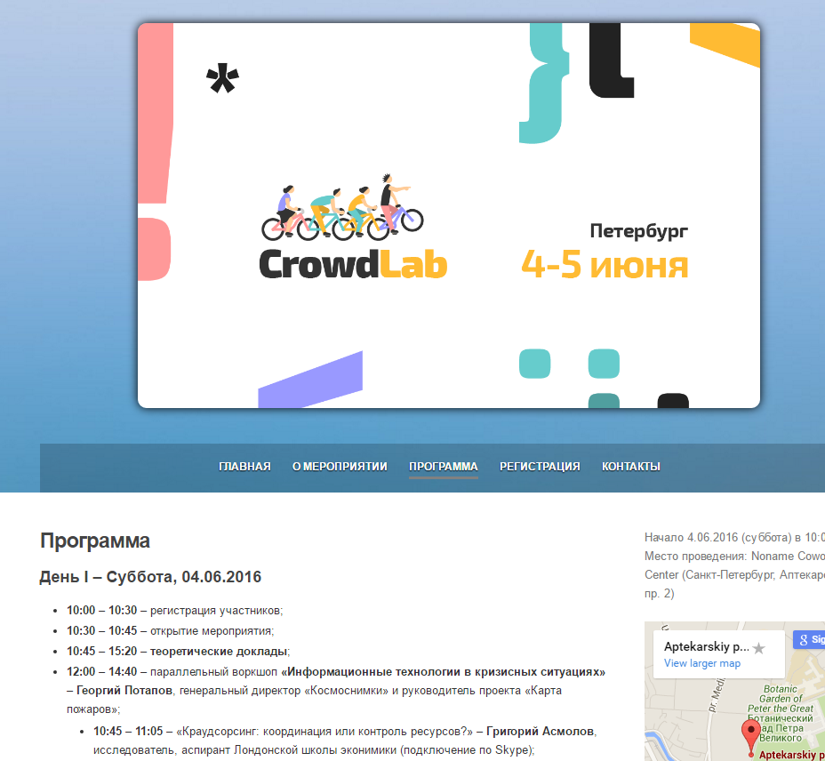
CrowdLab Today/Tomorrow
Аптекарский пр. 2

Slide 25
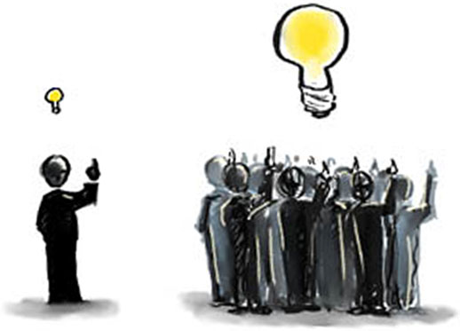

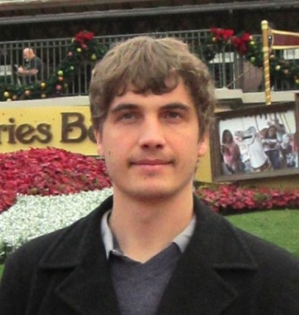
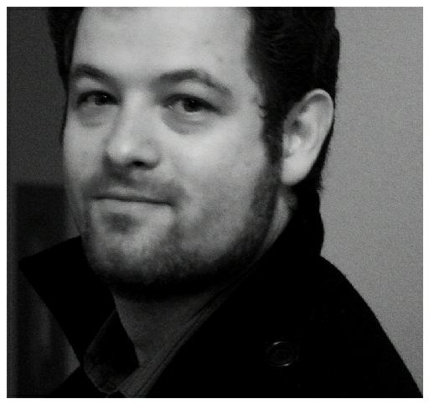





Program Boosting: Program Synthesis via Crowd-Sourcing
Robby Cochran
Robert Cochran
Loris D’Antoni
Benjamin Livshits
David Molnar
Margus Veanes
Notes:
30s intro
Overall experience
Background
Worked on areas w/o prior experience

Slide 26
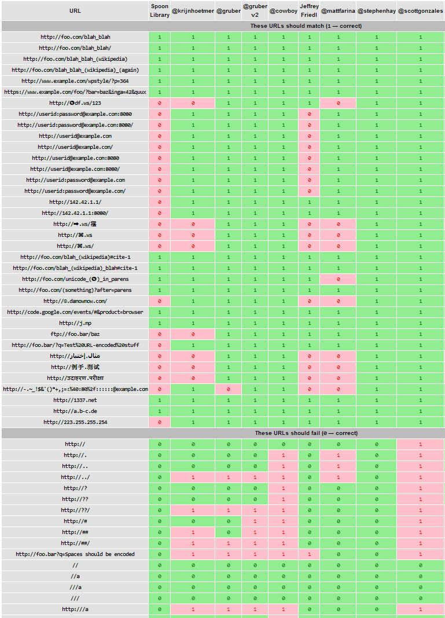



In Search of the Perfect URL Validation Regex
http://mathiasbynens.be/url-regex
Matias Bynens
Submissions:
@krijnhoetmer
@cowboy
@mattfarina
@stephenhay
@scottgonzales
@rodneyrehm
@imme_emosol
@diegoperini
“I’m looking for a decent regular expression to validate URLs.”
- @mathias
Notes:
Goal: Perfect Regex
Approach: advertise task on twitter
Judge: using positive and negative examples

Slide 27
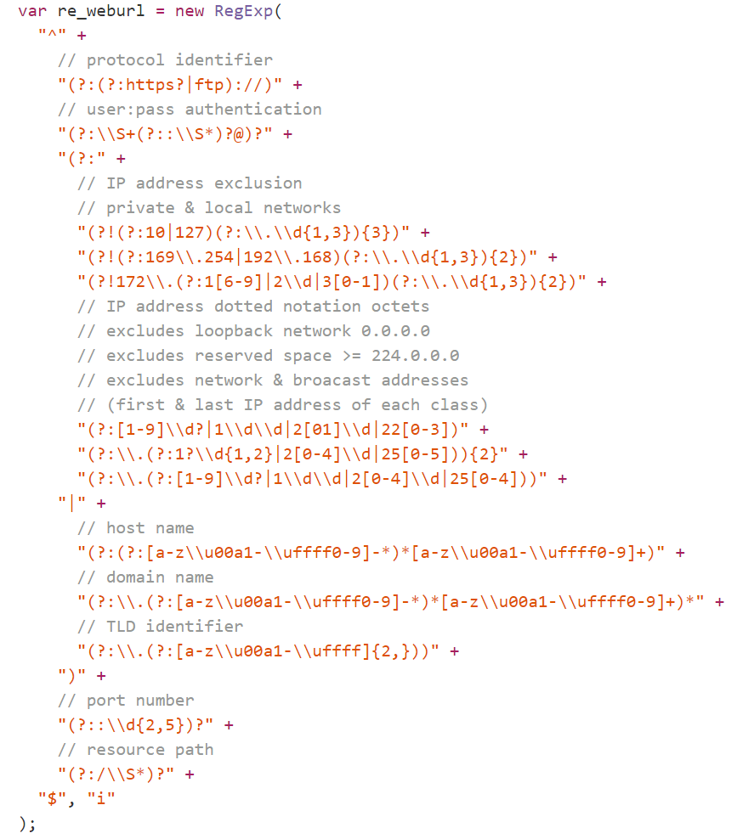
Winning Regular Expression

Slide 28
Proposed Regexes
Notes:
We chose starting examples based on Mathias + Manually

Slide 29
Key Insight for Crowd-Sourcing of Programs
Regular expressions
CrowdBoost
Most people get easy cases right
People produce solutions that work well for positive examples
…but bad at rejecting negative examples – more permissive than they should be
However, piecing together different solutions will produce a good score on the examples
In this project we apply this intuition to programs
We call this program boosting
CrowdBoost is the system we built:
  Crowd-source initial programs
  “Blend” them together
  Refine the result

Slide 30
Overview of Program Boosting
Training set
Provided by whoever defines the task
Initial programs
Get something right
Specification
Textual description
Open to interpretation
Positive and negative examples
But usually get something wrong
Specification is often elusive and incomplete
Reasonable people can disagree on individual cases
Broad space of inputs difficult to get full test coverage for
Easy to get started, tough to get “absolute precision” or correctness
Notes:
I’m not going to give you specific details, here but I want to highlight how this approach could be applied in different domains

Slide 31
Potential Application: Sanitizers
Sanitizers for Security
  String manipulating sanitization functions on untrusted data
  Can be modeled as transducers (automata with output)
Training set
Input/output pairs
Initial programs
Sanitizers produced by developers
Specification
“Write an HTML sanitizer”
program sanitize(t);
string s;
s := iter(c in t) {b := false;} {
case (!(b) && ((c == '\'') || (c == '\"'))):
b := false;
yield ('\\');
yield (c);
case (c == '\\') :
b := !(b);
yield (c);
case (true) :
b := false;
yield (c);
};
return s;
&
&amp;
Notes:
The same property holds here, developers get them right for the obvious cases, but miss on corner cases, but different ones, this is the hope of program boosting, that better results could come from blending

Slide 32
Potential Application: Sanitizers
Loop-manipulating programs
Take programs that manipulate loops over a buffer
Surgery: swap the loops in and out
Check the result
program sanitize(t);
string s;
s := iter(c in t) {b := false;} {
case (!(b) && ((c == '\'') || (c == '\"'))):
b := false;
yield ('\\');
yield (c);
case (c == '\\') :
b := !(b);
yield (c);
case (true) :
b := false;
yield (c);
};
return s;
Notes:
The same property holds here, developers get them right for the obvious cases, but miss on corner cases, but different ones, this is the hope of program boosting, that better results could come from blending

Slide 33
Outline
Vision and motivation
Our approach: CrowdBoost
Technical details: regular expressions and SFAs
Crowd-sourcing setup
Experiments

Slide 34

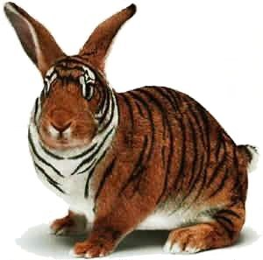
CrowdBoost Outline
Crowd-source initial programs
We use genetic programming approach for blending
Needed program operations:
  Shuffles (2 programs => program)
  Mutations (program => program)
  Training Set Generation and Refinement (program => labeled examples)
ID | Label
Ex1 | +
Ex2 | -
Ex3 | +
Ex4 | -

Slide 35
Example of Boosting in Action
Input 1 (0.53)
Input 2 (0.58)
Mutation
(0.60)
Shuffle
(0.62)
Mutation
(0.60)
Mutation
(0.50)
Mutation
(0.69)
Shuffle
(0.63)
…
Winner!
(0.85)
Notes:
We have a notion of fitness, which is simply how well we perform on the example set
One undesirable result however is that we may have a problem with over fitting to the training set.

Slide 36

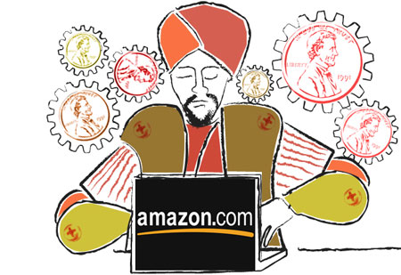
How Do We Measure Quality?
Measuring fitness
Training Set Coverage
Percentage of tests cases that the current candidate program gets right
  Accepts for positive
  Rejects for negative
Others are possible
  Weight initial examples more heavily
  Penalize for larger and more complex candidates to avoid overfitting
Possible Input Space
?
+
Initial Examples
“Gold Set”
-
+
+
-
+
?
-
?
+
-
?
?
+
+
-
-
?
?
-
+
?
+
?
+
+
?
?
+
-
+
?
?
Notes:
Change formulas to consider sizes

Slide 37







Skilled and Unskilled Crowds
Skilled: provide initial programs
Unskilled: evolve training examples
More expensive, longer (hours)
May require multiple rounds of interaction
Different payment models
Cheaper, smaller units of work (seconds or minutes)
Automated process for hiring, vetting and retrieving work
Notes:
Skilled Task: Implements a program that fit’s their interpretation of a given spec.
LowSkilled Task: Given a spec, can tell if it matches the spec, i.e. is this a valid email address?

Slide 38
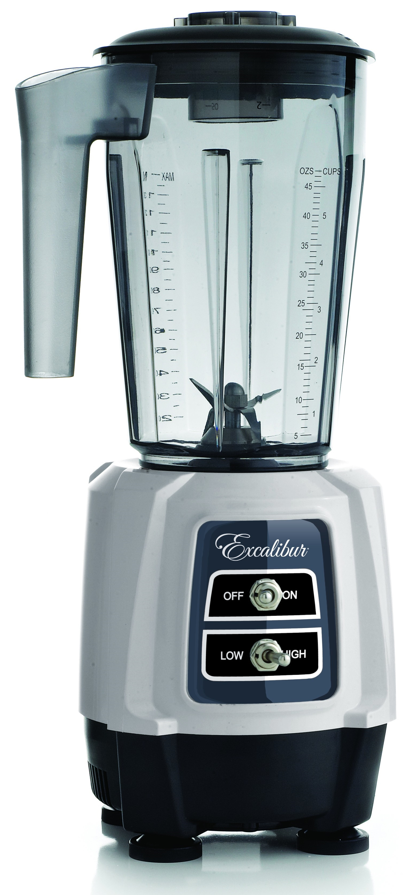
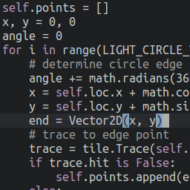

Overview
Shuffle / Mutate
Refine training set
Select successful candidates
Assess fitness
Specification
Initial Examples
“Gold Set”
-
-
+
+
+
-
CrowdBoost
$$Accuracy=\frac{+/−}{Total }$$

Slide 39
Outline
Vision and motivation
Our approach: CrowdBoost
Technical details: regular expressions and SFAs
Crowd-sourcing setup
Experiments

Slide 40
Working with Regular Expressions
Our approach is general
Tradeoff: expressiveness VS complexity
Our results are very specific
We use a restricted notion of programs
Regular expressions permit efficient implementations of key operations
  Shuffles
  Mutations (positive and negative)
  Training Set Generation

Slide 41
Symbolic Finite Automata
Extension of classical finite state automata
Allow transitions to be labeled with predicates
Need to handle UTF16
  2¹⁶ characters
Implemented using Automata.dll
Notes:
Callout to Loris and Margus
Will now describe Shuffles, Mutations and Training Set refinements in the domain of SFAs
I’m going to give a high level description,
these algorithms were developed by loris and margus and not trivial,
if you want more details please take a look the draft of our paper.

Slide 42
SFA Shuffle: Overview
Not all shuffles are successful.
Success rates are sometimes less than 1%
Perform “surgery” on A and B
The goal is to get them to align well
Large number of combinatorial possibilities: may not scale
  Very high complexity
  We also don’t want to swap random edges, we want to have an alignment between A and B
A
B
i₂
i₁

Slide 43
Shuffle Heuristics: Collapsing into Components
Manageable number of edges to shuffle
Stretches
SCC
One-Entry
One-Exit

Slide 44
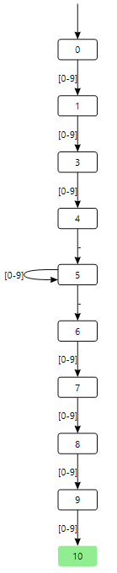
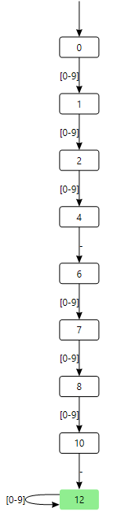
SFA Shuffle: Example
A
B
Regular expressions for phone numbers
  ^[0-9]{3}-[0-9]*-[0-9]{4}$
  ^[0-9]{3}-[0-9]{3}-[0-9]*$
  Shuffle:
  ^[0-9]{3}-[0-9]{3}-[0-9]{4}$

Slide 45
SFA Mutation
Positive Mutation: ftp://foo.com
Negative Mutation: http://#
Add edge for “f”
Remove “#”
Notes:
Examples, not a full description of the algorithm

Slide 46
Training Set Refinement
Goal: make sure our training set gives full state coverage for our candidate automata
Define a language L of strings reaching an uncovered state
Generate strings to cover more states
✔
State to cover
✔
✔
✔
Generate new string
✔
✔
✔
✔
✔
✔
✔
✔
✔
✔

Slide 47
Training Set Generation
Choose string s ∈ L(A) randomly
    https://f.o/..Q/
    ftp://1.bd:9/:44ZW1
    http://h:68576/:X
    https://f68.ug.dk.it.no.fm
    ftp://hz8.bh8.fzpd85.frn7..
    ftp://i4.ncm2.lkxp.r9..:5811
    ftp://bi.mt..:349/
    http://n.ytnsw.yt.ee8o.w.fos.o
Given a string e, choose string s ∈ L(A) with minimal edit distance to e
  e = “http://youtube.com”
    Whttp://youtube.com
    http://y_outube.com
    h_ttp://youtube.com
    WWWhttp://youtube.co/m
    http://yout.pe.com
    ftp://yo.tube.com
    http://y.foutube.com

Slide 48
Outline
Vision and motivation
Our approach: CrowdBoost
Technical details: regular expressions and SFAs
Crowd-sourcing setup
Experiments

Slide 49
Four Crowd-Sourcing Tasks
We consider 4 tasks
  Phone numbers
  Dates
  Emails
  URLs
Notes:
Increasing order of complexity

Slide 50
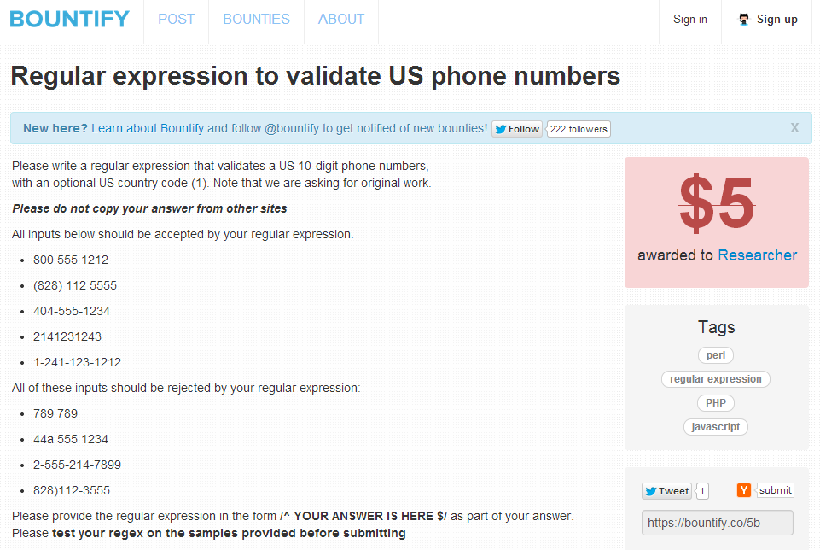
Bountify Experience

Slide 51
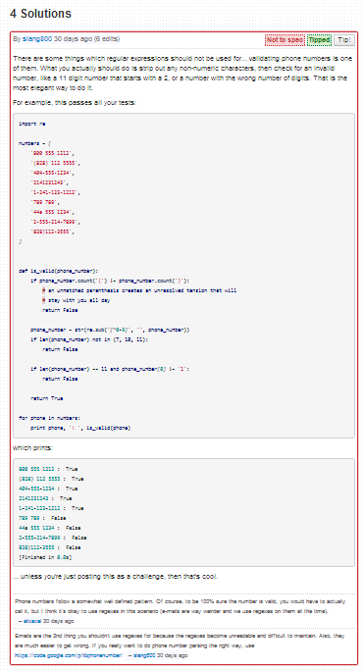
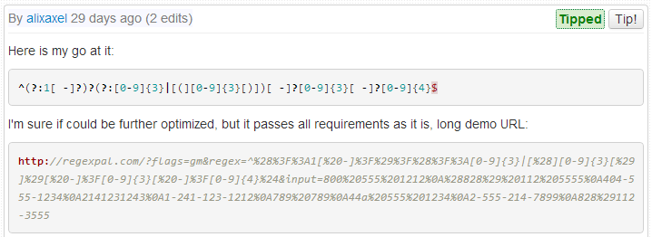
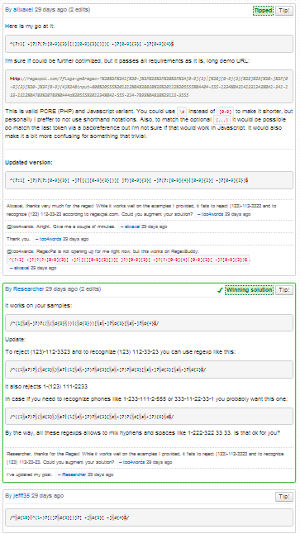
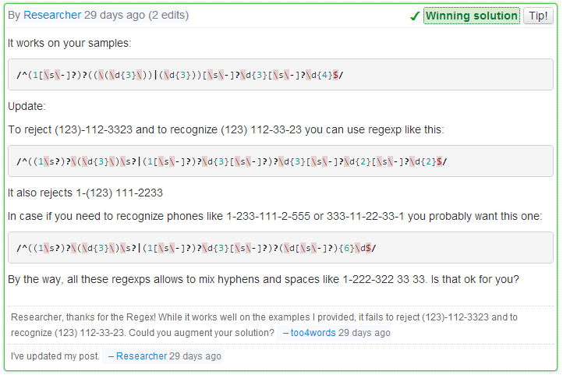
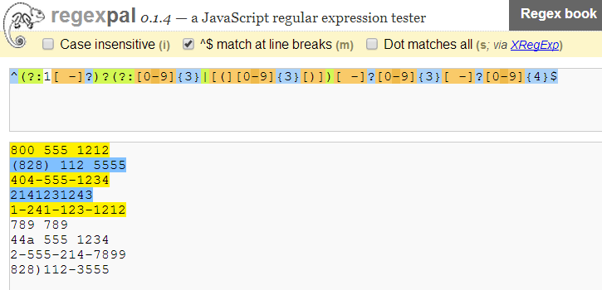
Bountify Process
Solution 2
Winner
Solution 4
Notes:
Simplified

Slide 52
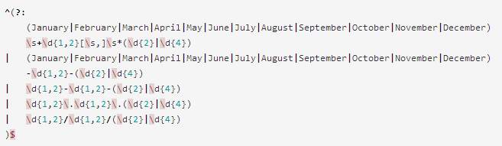
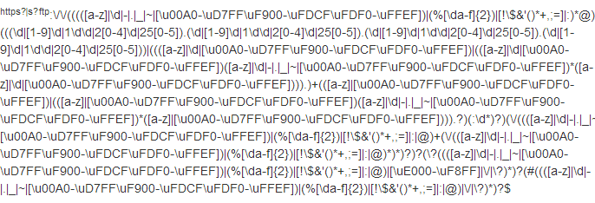
Some Regexes

Slide 53
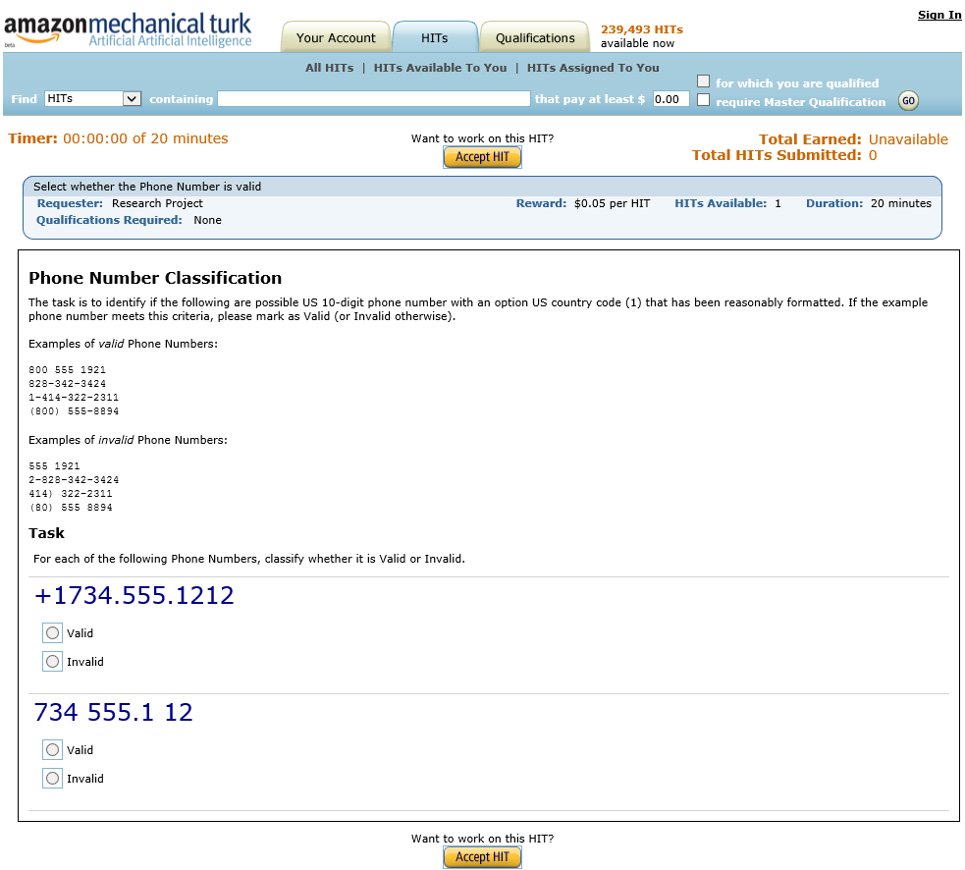
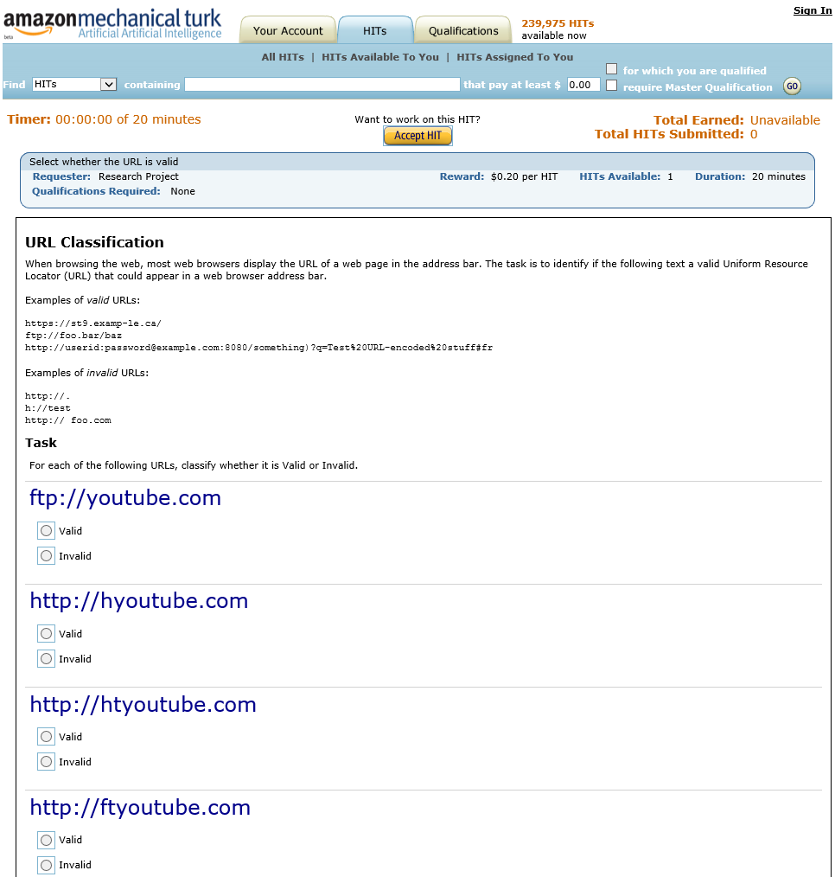
Worker Interface to Classify Strings

Slide 54
Outline
Vision and motivation
Our approach: CrowdBoost
Technical details: regular expressions and SFAs
Crowd-sourcing setup
Experiments

Slide 55


Experimental Setup
Measure fitness using gold and refined example set
Generate examples using edit distance for state coverage
Classify new examples using Mturk
Select successful candidates
SFA Shuffle / SFA Mutate
Specification:
Phone, Email, Date or URL
Initial Examples
“Gold Set”
72+ / 90-
-
-
+
+
+
Results measured:
Boost in fitness
Mturk costs
Worker latency
Running times
-
Evolution
Process
465 experiments (pairs)
30 total regexes.
10 from Bountify, 20 found online.

Slide 56
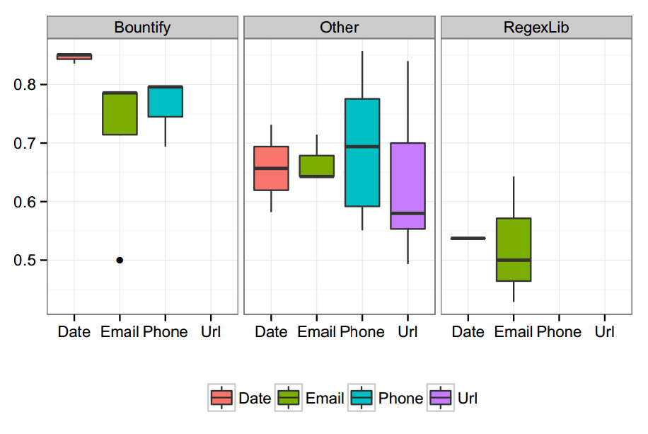
Initial Fitness
Pretty high to start with for Bountify
For regexlib, some candidates are low fitness
URLs seem difficult and have more variety in fitness values
Notes:
Initial fitness values varied across the board, our hope is that we can see improvements, even if the initial fitness is high.

Slide 57
Characterizing the Boosting Process
Two representative pairs profiled from each category
Want the process to terminate: limit the # of generations to 10
  Occasionally, all are required
  Often finish after 5 or 6 generations
While we hit a plateau at 10, in some cases we’re likely to improve with more generations

Slide 58
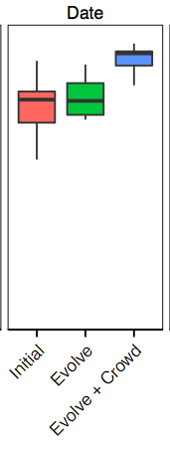
Final Fitness After Boosting
Final fitness
upwards of 90%
Positive boost
Notes:
Here are our overall boosting results
We start by just looking at the results for the date specification…

Slide 59
Latency
Larger batches for workers
Total
Notes:
mturk is fully automated
larger batches require more time
These results show the overall time spent waiting for results from mechanical turk

Slide 60
Mechanical Turk Costs
Classification tasks were batched into varying sizes (max 50) and had scaled payment rates ($0.5 - $1.00)
5 workers per batch
Median cost per pair: $1.5 to $8.9
Notes:
Move description 1 or 2 behind

Slide 61
Conclusions
Programs that implement non-trivial tasks can be crowd-sourced effectively
We focus on tasks that defy easy specification and involve controversy
CrowdBoost: use genetic programming, to produce an improvement in quality of crowdsourced programs
Experiments with regular expressions
Tested on 4 complex tasks
  Phone numbers, Dates, Emails, URLs
Considered pairs of regexes from Bountify, RegexLib, etc.
CONSISTENT BOOSTS | 0.12 -0.28 median increase in fitness
MTURK LATENCY | 8 – 37 minutes per iteration
RUNNING TIME | 10 minutes to 2 hours
MTURK COSTS | $1.40 to $9.00
Notes:
Overall = including shuffles

